Slide 1














PAVING THE WAY TO LEADERSHIP
Laying the Groundwork for Success at the
Alabama FBLA State Leadership Conference!
April 18-19, 2024
Notes:
Hello Alabama FBLA Members and Advisers! My name is Kendi McHargh, I am a Junior at Central High School Tuscaloosa, and I have the honor to serve as your 2023-2024 Alabama FBLA State President. We are so excited and glad to have you join us today as we continue paving the way to leadership. This webinar will provide each of you with valuable information to prepare you and your chapter members for Career Technical Student Organization conferences and workshops, including the largest gathering of Alabama FBLA members, our State Leadership Conference, or SLC.

Slide 2
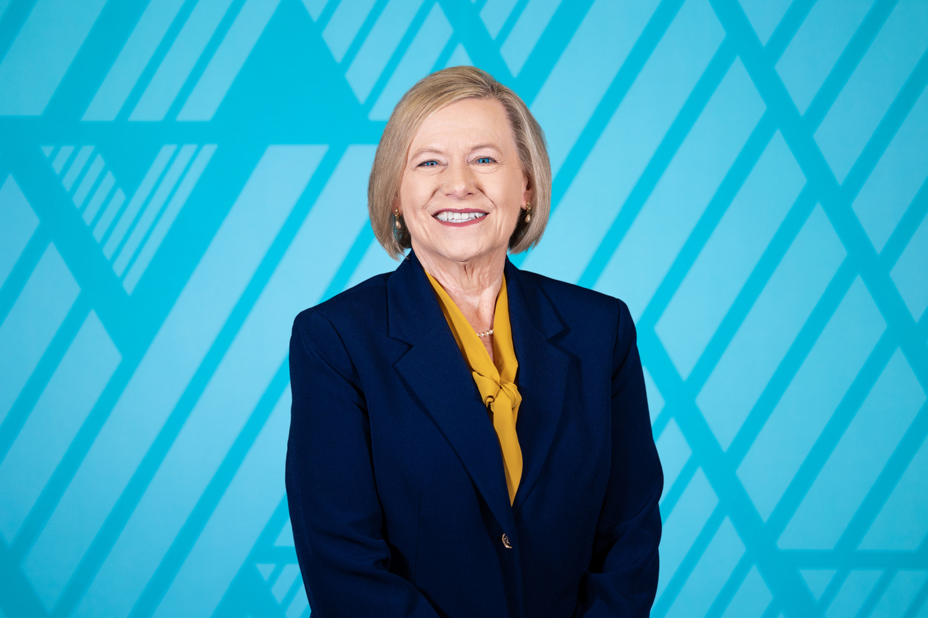
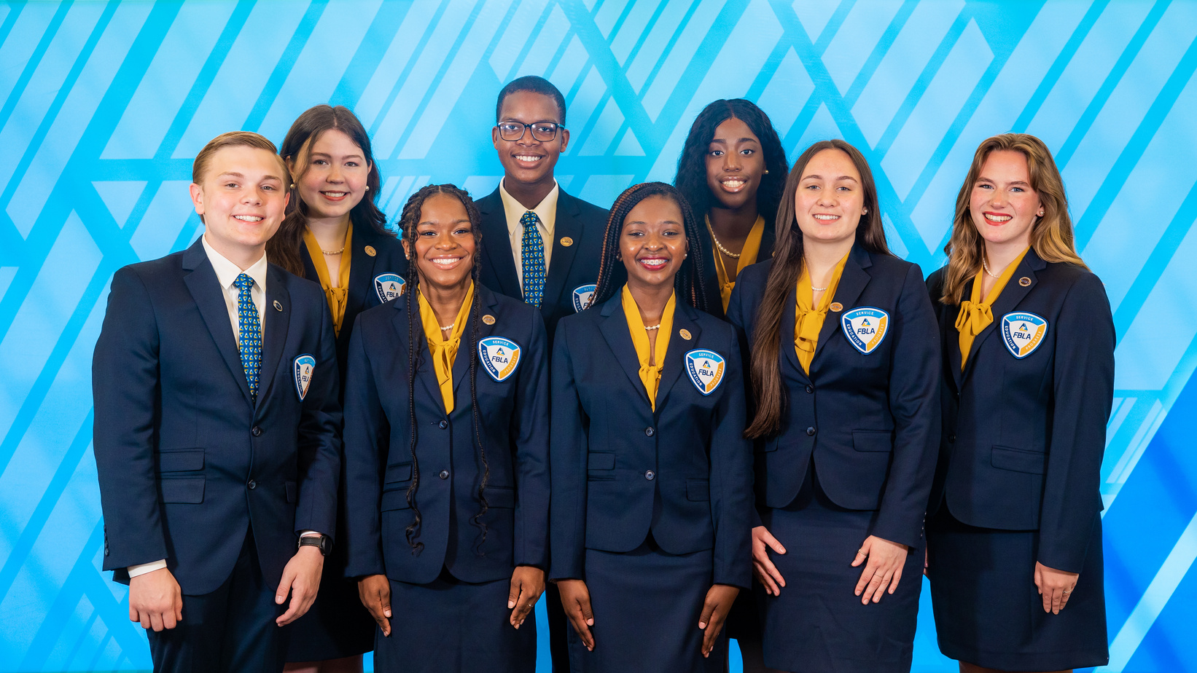
2023-2024 Alabama FBLA
State Officer Team
Mrs. Lisa Weeks
Alabama FBLA State Adviser
Notes:
Our State Leadership Team and Council members put this webinar together, to help attendees learn more about our State Leadership Conference. At the 2023 State Leadership Conference, voting delegates elected the 2023-2024 State Leadership Team. The State Leadership Team consists of our State President and Secretary, six District Vice Presidents, eight State Officer Advisers, and our amazing State Adviser, Mrs. Lisa Weeks. Before we continue, our State Officers and Council Members will be introducing themselves!

Slide 3
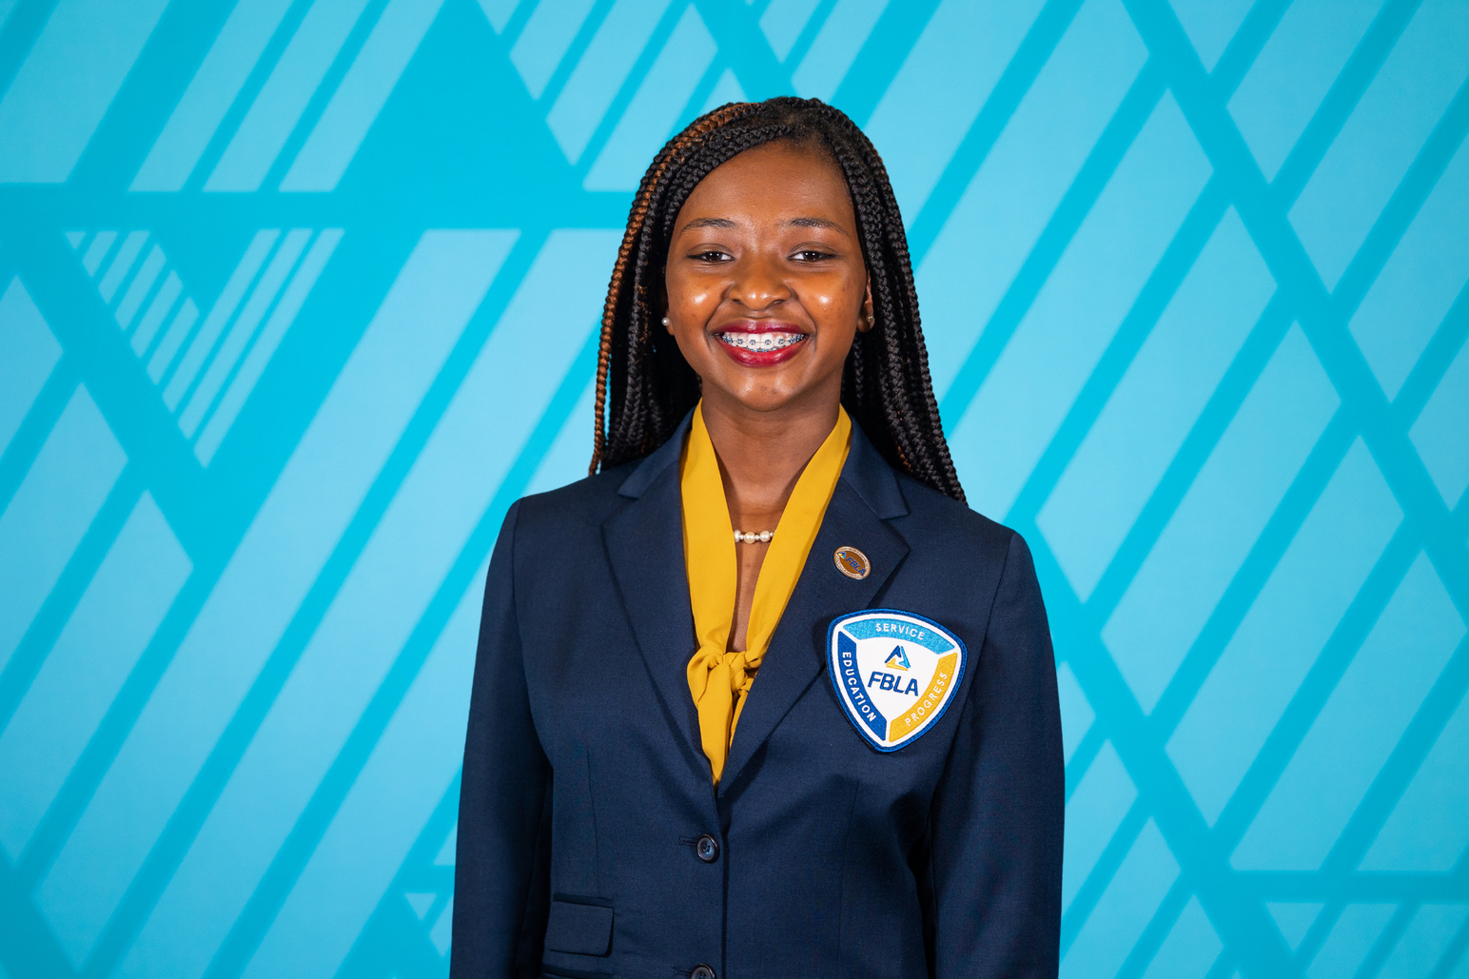
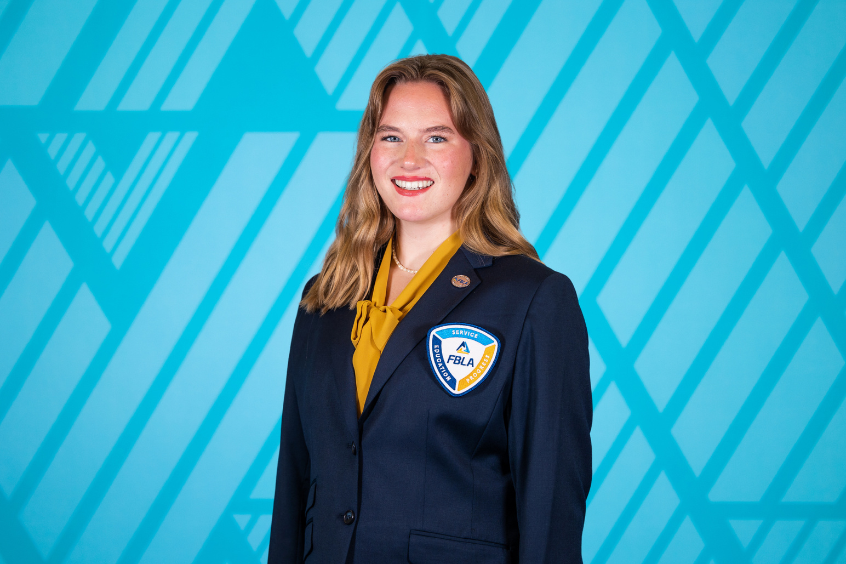
State President
State Secretary
Kendi McHargh
Central High School Tuscaloosa
Madilyn Hanback
Rogers High School
Notes:
Once again, hello everyone! My name is Kendi McHargh, I am a junior at Central High School Tuscaloosa, and I currently serve as the 2023-2024 Alabama FBLA State President. Thank you all so much for joining us tonight!
Hello everyone! My name is Madilyn Hanback and I currently serve as the 2023-2024 Alabama FBLA State Secretary! I am a junior at Rogers High School!

Slide 4
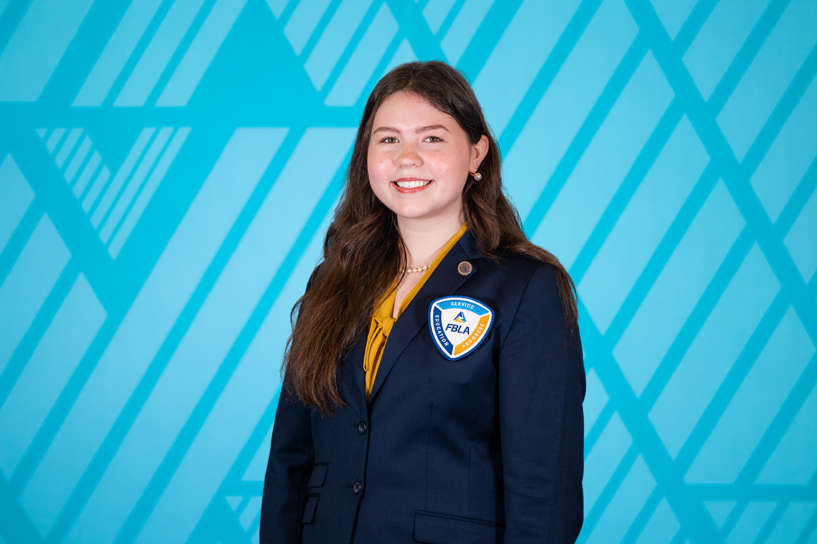
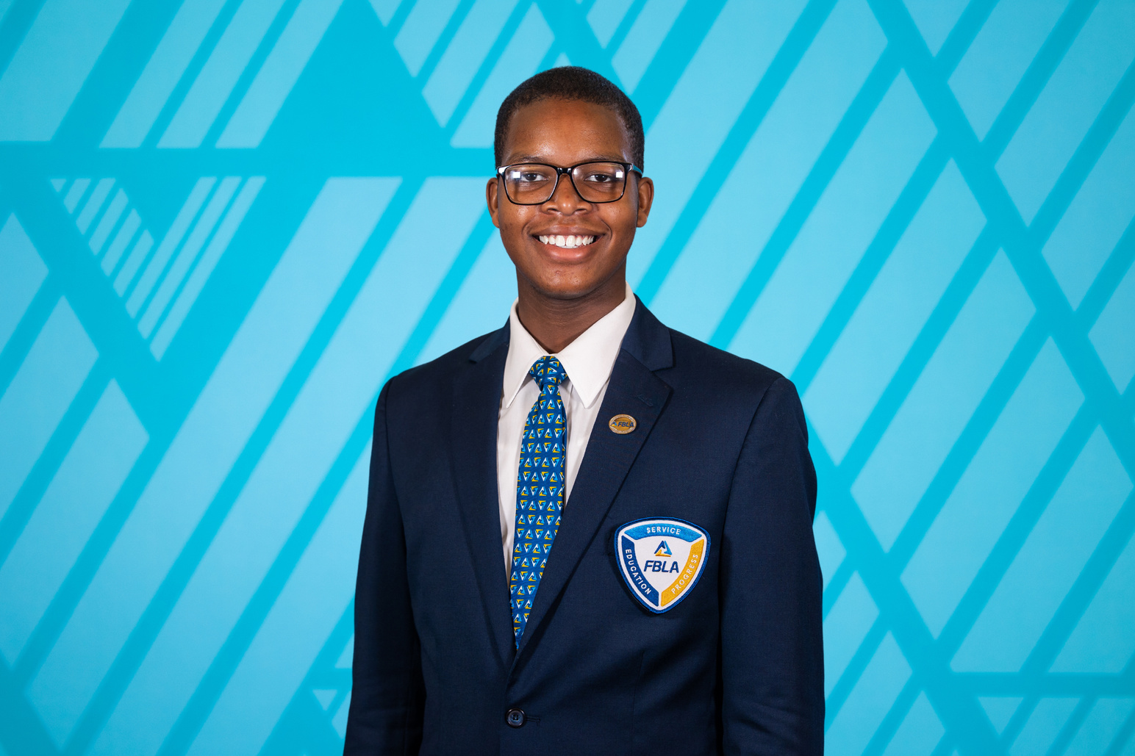
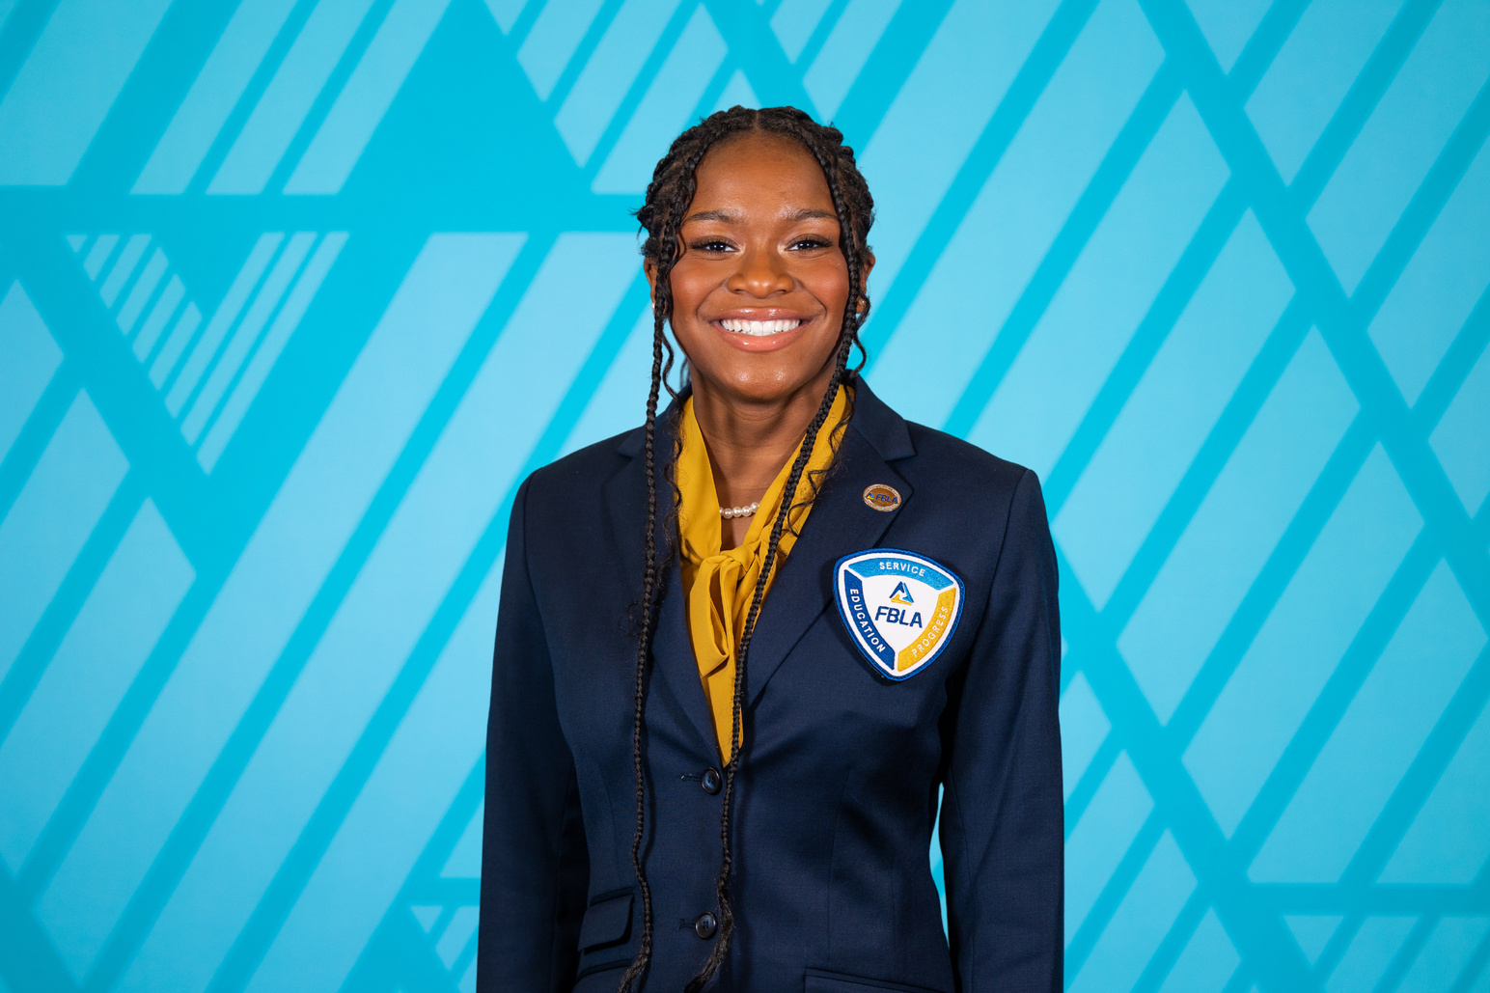
District 1 VP
District 2 VP
District 3 VP
Catherine McWhorter
Priceville High School
Jared White
Central High School Tuscaloosa
Armani Dixon
Saraland High School
Notes:
Slide 4: Good evening! I am Catherine McWhorter! I am a senior at Priceville High School, and I am the District 1 Vice President for 2023-2024.
Slide 4: Great evening everyone! My name is Jared White, I am a Sophomore at Central High School Tuscaloosa and I currently serve as your 2023-2024 District 2 Vice President.
Slide 4: Hello everyone!! My name is Armani Dixon. I am your 2023-2024 District 3 Vice President. I am a senior at Saraland High School.

Slide 5
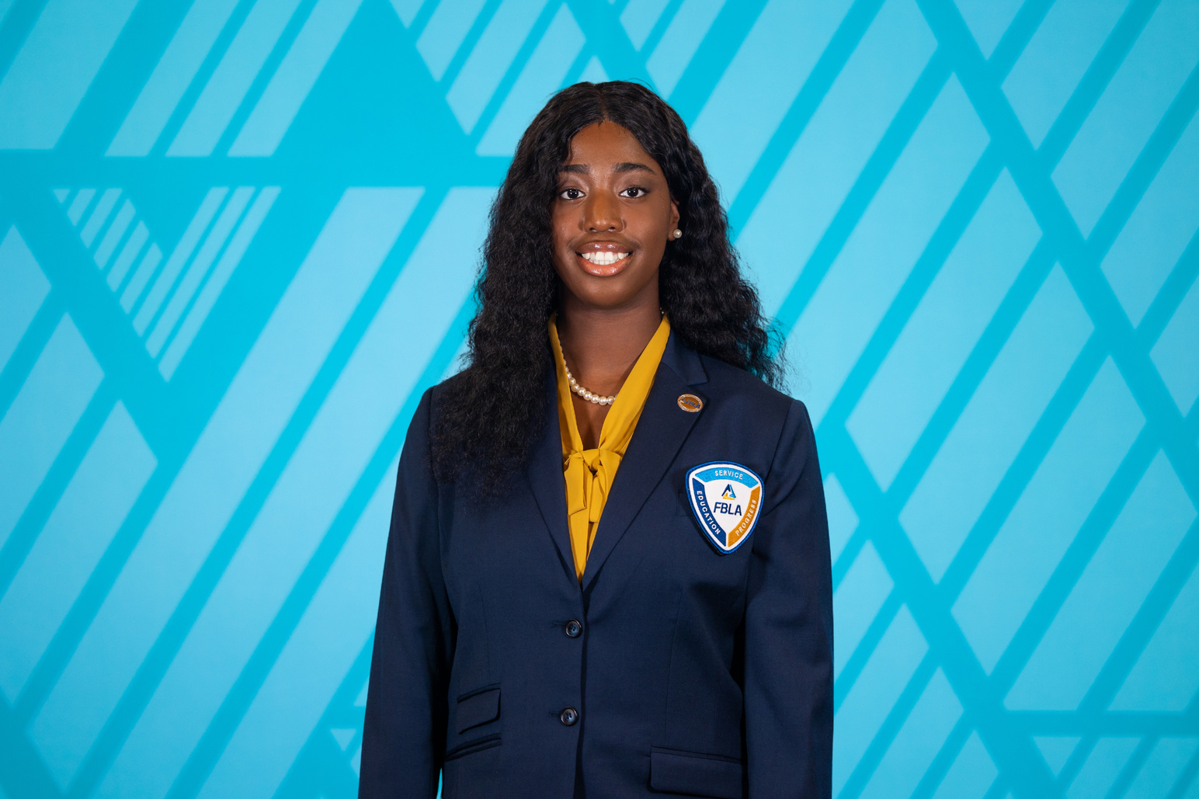
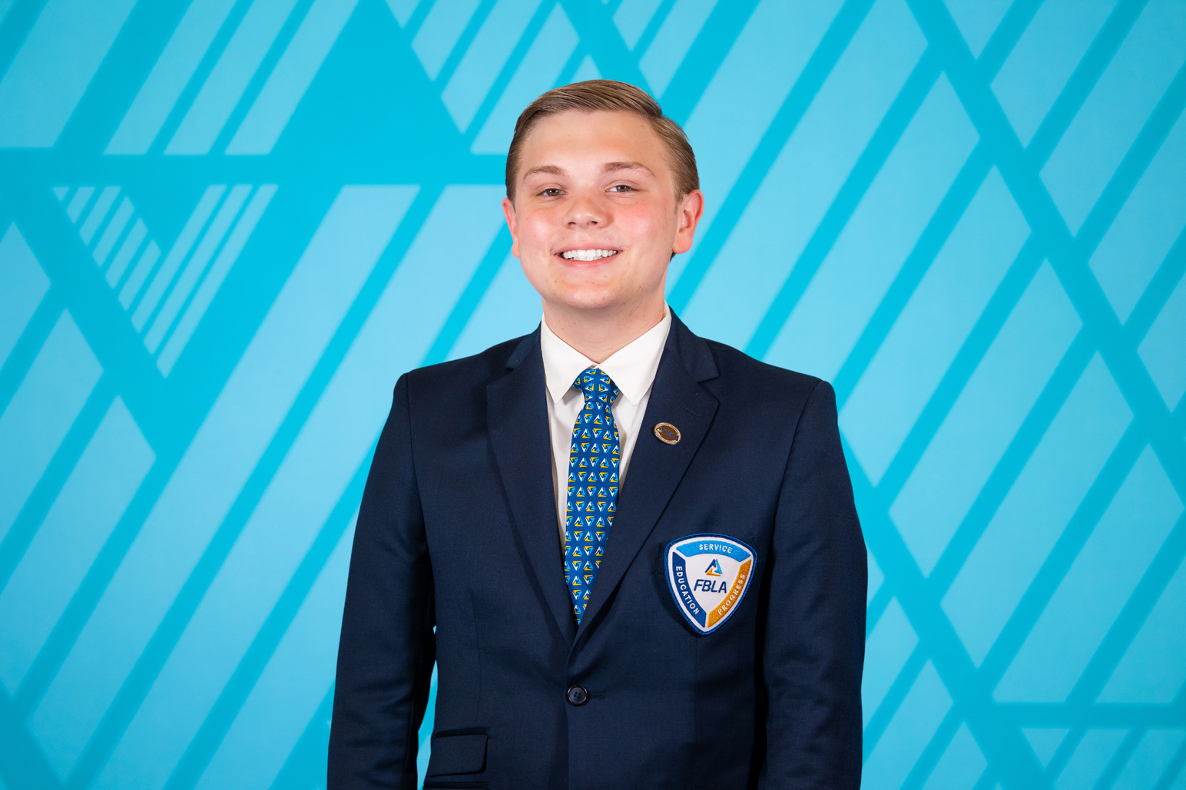
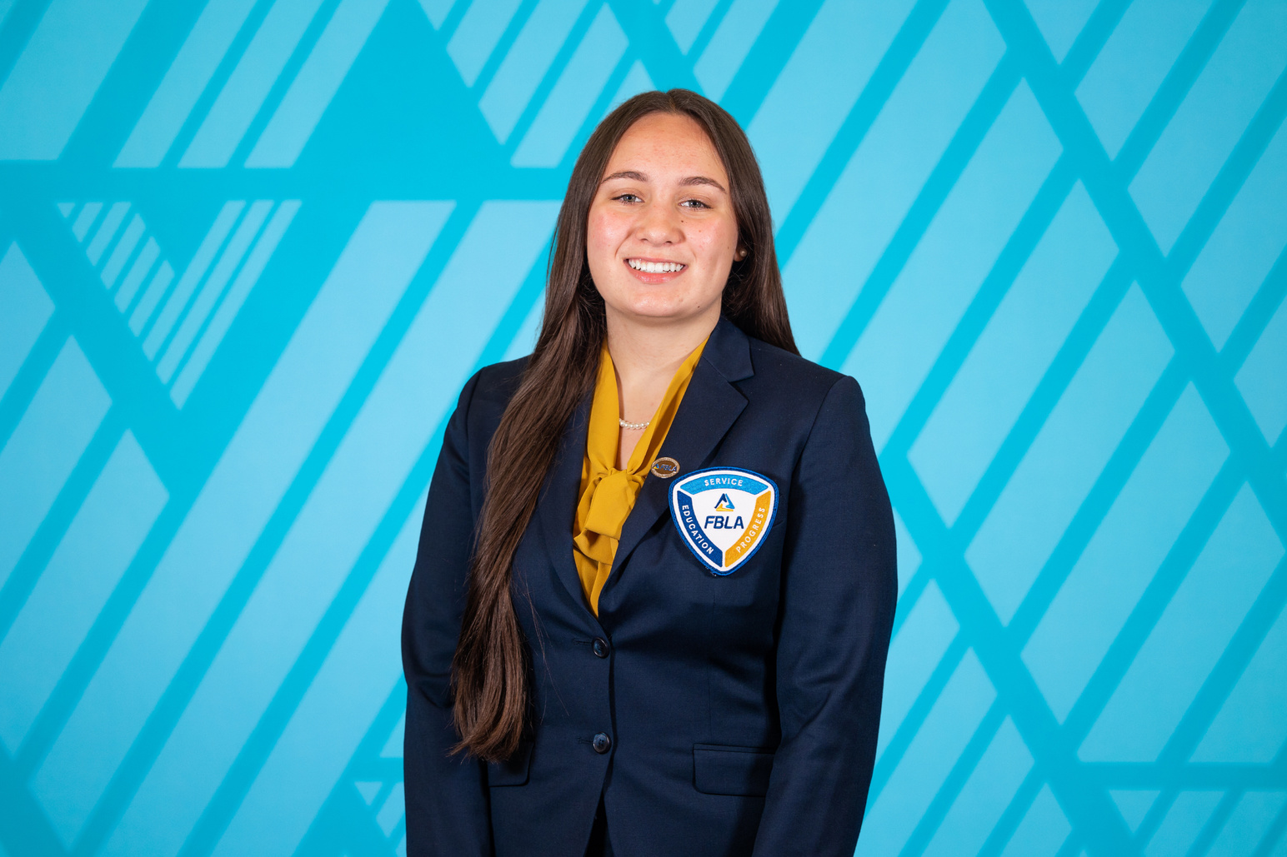
District 4 VP
District 5 VP
District 6 VP
Shar’Dajai Harris
Lowndes County Career Technical Center
Carson DuBose
Eden Career Technical Center
Greyson Sparks
Albertville High School
Notes:
Slide 5: Hi everyone! My name is Shardajai Harris. I am your 2023-2024 District 4 Vice President. I am a senior at Lowndes County CTC. I hope that you guys enjoy this webinar and retain a lot of information.
(Your District 4 Vice President is Shar'Dajai Harris. She is a senior at Lowndes County Career Technical Center and she is glad to serve the members of Alabama FBLA!)
Slide 5: Hey guys! I am Carson DuBose, your District 5 Vice President and I am a senior at Springville High School and I attend Eden Career Technical Center. I am so glad everyone could join us for this and hopefully you can walk away with some beneficial information.
Slide 5: Hello! My name is Greyson Sparks I am a junior at Albertville High and I currently serve as the 2023-2024 District 6 V.P.

Slide 6
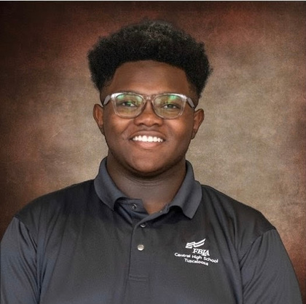
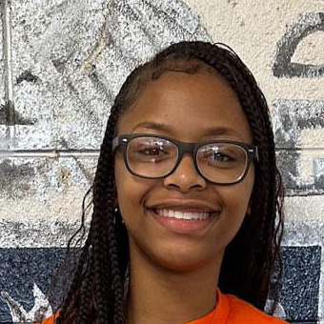
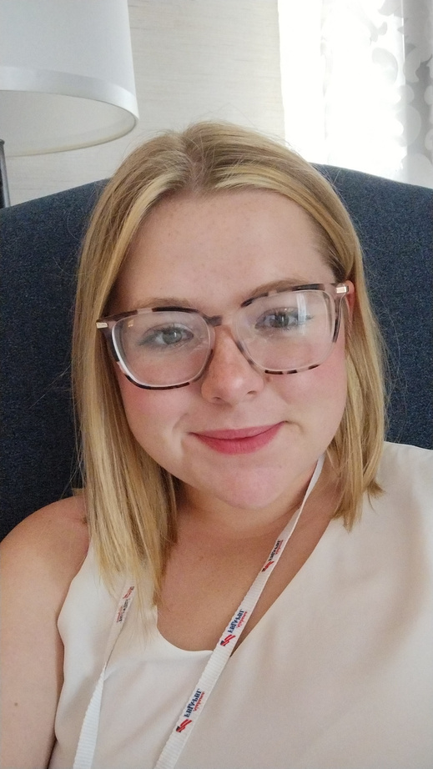
District 1
Council Representative
District 2
Council Representative
District 3
Council Representative
Joshua Long
Central High School Tuscaloosa
Erianna Jones
Francis Marion High School
Catherine Williams
Excel High School
Notes:
Hello! My name is Joshua Long. I am a junior at Central High School- Tuscaloosa. I serve as the 2023-2024 District I Representative. I am so ecstatic to be a part of the State Leadership Council and serve you all!
Hello everyone! I am Erianna Jones. I am a sophomore at Francis Marion School and I serve as your 2024 -2023 District II Representative.
(Alternate Introduction: Your District 2 Representative is Erianna Jones. She is a sophomore at Francis Marion High School.)
Hi everyone! My name is Catherine Williams, ( but I go by Kate), I am a junior at Excel High School and I am super excited to be serving as your District 3 State representative.

Slide 7
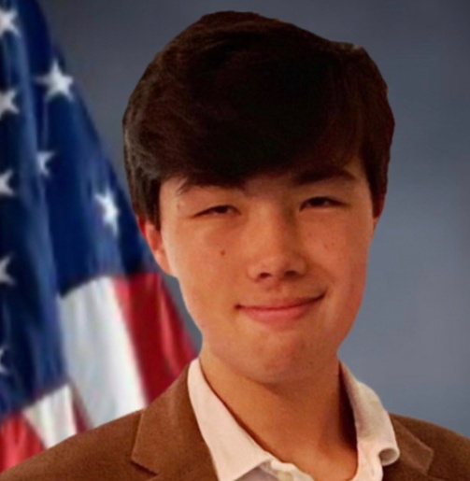
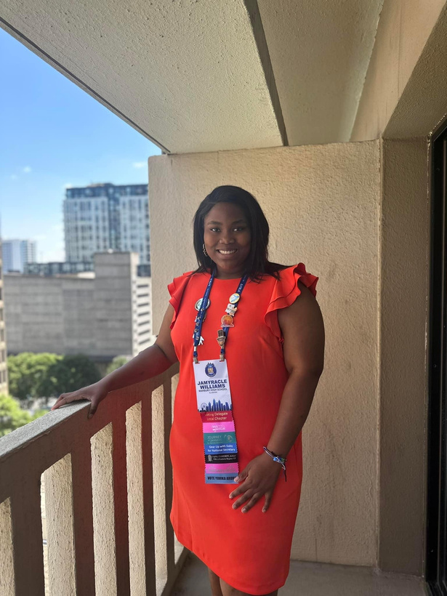
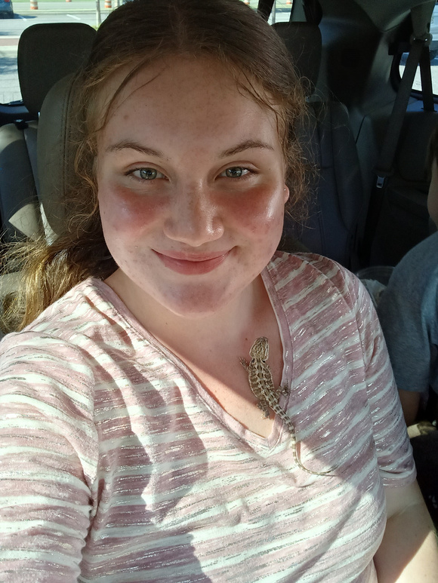
District 4
Council Representative
District 5
Council Representative
District 6
Council Representative
Luke Lawson
Headland High School
Jamyracle Williams
Marbury High School
Soraya Casey
Oxford High School
Notes:
Slide 7:Hello! My name is Luke Lawson, I am a freshman at Headland High School. I serve as my chapters president as well as district 4 representative on the state leadership council. I look forward to serving you in anyway that I can!
(Alternate Introduction: Your District 4 Representative is Luke Lawson. He is a freshman at Headland High School.)
Slide 7: Hello! My name is Jamyracle Williams, and I am a junior at Marbury High School.
(Alternate Introduction: Your District 5 Representative is Jamyracle Williams. She is a junior at Marbury High School.)
Slide 7: Hello! My name is Soraya Casey, I am a Sophomore at Oxford High School. I serve as the 2023-2024 District 6 Representative. I look forward to the wonderful opportunities this year!
(Alternate Introduction: Your District 6 Representative is Soraya Casey. She is a sophomore at Oxford High School.)

Slide 8

Middle School
Council Representative
Takiyah Westry
Camden School of
Arts and Technology
Notes:
(Alternate Introduction: Your Middle School Representative is Takiya Westry. She is a student at the Camden School of Arts and Technology)

Slide 9












FBLA State Leadership Conference
Competitive
Events
Tonight’s Objectives
Conference Etiquette
Running for State Office
Dress Codes
Staying Connected
Notes:
So now, let’s take a look at tonight’s objectives. This webinar will give you information all about the 2024 State Leadership Conference, FBLA Conference Etiquette, Dress Codes, Competitive Events, Running for State Office, and Staying Connected, because Together, We Achieve! If you have any questions, feel free to place them in the chat, or wait until the end for our question and answer session.

Slide 10


WHAT IS SLC?
Alabama FBLA State Leadership Conference
WHEN IS SLC?
April 18-19th, 2024
Arthur R. Outlaw Mobile Convention Center
WHY SHOULD I LOOK FORWARD TO ATTENDING SLC?
It is a fantastic opportunity to meet new people,
try new things, and create lasting memories

Slide 11




CONFERENCE ETIQUETTE

Slide 12
HOTEL REMINDERS
  You will be in hotels with other guests, so make sure to behave in a courteous and considerate manner.
  Do not wear your pajamas and slippers or house shoes in the lobbies, hallways, or general areas of your hotels.
  Remember, you are the Future Business Leaders of America, and you are expected to behave as such.

Slide 13


DO’S AND DON’TS!
Be Friendly!
Be Respectful!
Be Prepared!
Be Early and On-time!
Notes:
Be friendly! A primary goal of attending SLC, besides the amazing workshops, is to network and make new friends with FBLA members across the state. Be prepared and respectful. Bring pens, paper, pencils, and notepads to take notes during sessions. Be respectful of the presenters by limiting your side conversations, having little to no cell phone use unless requested by the presenter, and staying until the end of the session, whether it is a workshop session or a general session.

Slide 14
DRESS CODE
Notes:
Now it’s time to get into Dress Code!

Slide 15


WHAT ARE DRESS CODES?
Dress Codes are an accepted way of dressing for a particular occasion or in a particular social group.
WHY DOES FBLA FOLLOW A DRESS CODE?
FBLA follows a dress code to uphold the professional image of the association and its members and to
prepare students for the business world.
Notes:
Let’s start by explaining what dress codes are. Dress Codes are an accepted way of dressing for a particular occasion or in a particular social group. This means that there are different dress codes for different occasions and events. FBLA specifically uses the business professional dress code and the business casual dress code. You may be asking yourself why does FBLA follow a dress code at conferences? FBLA follows dress codes to uphold the professional image of the association and its members. This means that FBLA wants its members to have a good reputation and to look their very best. It is also in place to prepare students for the business world. Once you get into the working world employers will expect you to be able to dress appropriately for the occasion and there is nothing more important to the FBLA association than making sure its members are prepared for success!

Slide 16

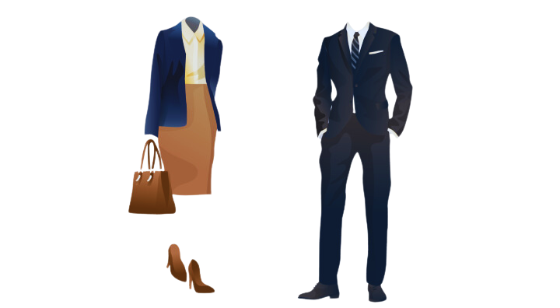
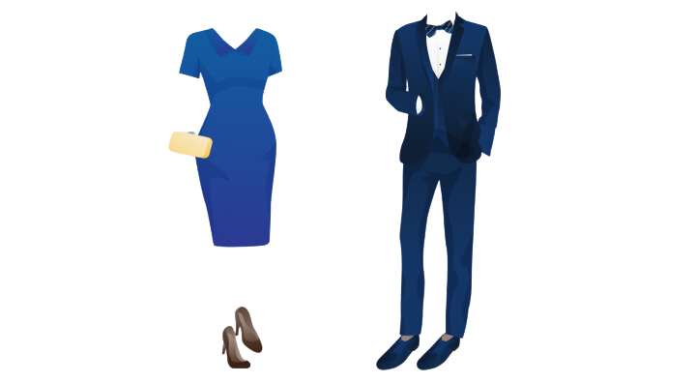
BUSINESS PROFESSIONAL DRESS CODE
ACCEPTABLE ITEMS FOR BUSINESS PROFESSIONAL DRESS CODE
Business professional is the most formal
level of professional dress.
Examples of business professional clothing: Blazers, dresses, suits, slacks, skirts
Notes:
What is a business professional dress code? The business professional dress code is the most formal level of professional dress. This style is most appropriate for interviews, career fairs, and more formal events. When it comes to acceptable items under a business professional dress code, clothing such as; blazers, dresses, skirts, slacks, blouses, suits, flats, or heels are acceptable.

Slide 17


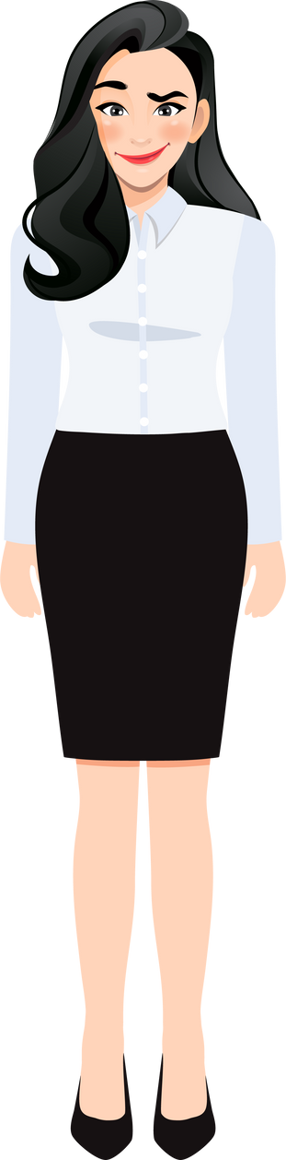



BUSINESS CASUAL
DRESS CODE
ACCEPTABLE ITEMS FOR BUSINESS CASUAL
DRESS CODE
Business casual is a dress code that blends traditional business wear with more relaxed attire.
Examples of business casual attire:
Polo shirts, khakis/chino-style pants, blouses
Notes:
What is business casual dress? Business casual is a dress code that combines elements of traditional business attire with more relaxed, comfortable clothing. It strikes a balance between professionalism and comfort, Business casual allows for a more relaxed work environment while still maintaining a polished look. The specific guidelines can vary among companies and industries. Business casual for FBLA students means blending professionalism with comfort, Typical items include Smart Tops: Polo shirts, blouses, or neat sweaters. Casual Bottoms: Khakis, chinos, or dress pants for comfort. Student-Friendly Shoes: Closed-toe shoes, or loafers. Jackets or Blazers and ties are optional for Events: This adds a touch of formality when needed.

Slide 18












WHERE TO PURCHASE
BUSINESS DRESS ITEMS
Notes:
You can find business dress items in almost any store that sells clothing such as TJ Maxx, Target, Walmart, Kohls, Amazon, and more! You can also find business dress items in thrift stores such as Goodwill, Salvation Army, America’s Thrift Stores, and more! You could even borrow from friends and family!

Slide 19


WHAT NOT TO WEAR
Casual or Athletic Attire
Revealing Outfits
Excessively Wrinkled Clothing
Extravagant Accessories
Notes:
1: When attending State Leadership Conference, Avoid wearing anything too casual or informal like jeans, t-shirts, sneakers, or flip-flops. Save those for more laid-back occasions.
2: It's important to choose outfits that are modest and professional. Avoid clothing that is too revealing, such as low-cut tops, short skirts, or clothing with offensive graphics or slogans
3. While it's great to express your personal style, avoid accessories that are overly flashy or distracting. Keep jewelry, ties, and other accessories tasteful and in line with the professional atmosphere.
4: Make sure your clothing is clean, well-pressed, and wrinkle-free. Avoid showing up with wrinkled shirts, pants, or skirts as it can give off an unprofessional impression. Remember, the goal is to present yourself in a professional and polished manner. By avoiding these fashion no-nos, you'll be sure to make a positive impression at the conference. If you have any more questions or need further guidance, feel free to ask!

Slide 20
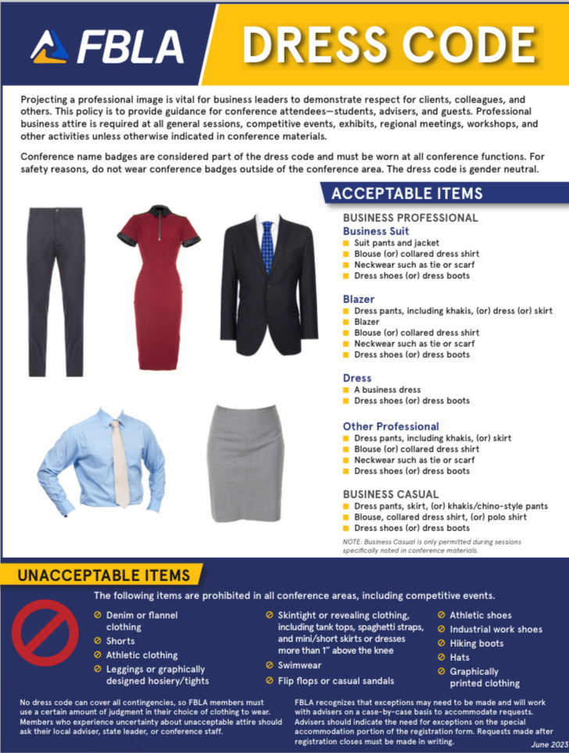

THE FBLA DRESS CODE
FBLA's Dress Code includes both Business Casual and Business Professional attire.
All SLC Attendees, including members, chaperones, and chapter advisers, must follow the dress code.
If you ever need to make sure a garment is acceptable, check out the FBLA National website.
Notes:
FBLA's Dress Code includes both Business Casual and Business Professional attire. Always wear professional clothes at general sessions, competitive events, exhibits, regional meetings, workshops, and other activities, unless conference materials say otherwise. Everyone must follow the dress code, including chaperones and advisors. And don't forget your conference badges; it's part of the Dress Code too! If you ever need to make sure a garment is acceptable don't hesitate to check out the National FBLA website. To find the FBLA dress code, go to fbla.org. Under the section labeled advisers, find resources, scroll down, and click on the hyperlinked dress code. This will take you to a pdf version of the current FBLA dress code, like the one you see here, with all the information you will need to be dressed to impress at each conference.

Slide 21
COMPETITIVE EVENTS
Notes:
Getting into competitive events, competing at the state leadership conference is an experience that you will never forget. There are a range of events you can pick to compete in and have the opportunity to advance to the national level.

Slide 22
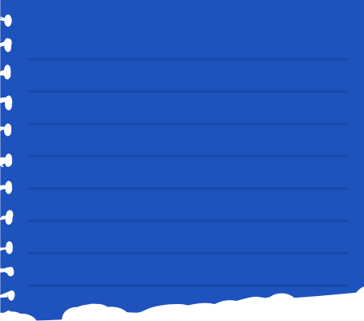

WHAT ARE FBLA COMPETITVE EVENTS?
FBLA competitive events prepare students for successful careers in business by providing opportunities to apply classroom concepts in a workforce-simulated competitive environment and allowing competitors to receive feedback from business professionals.
TYPES OF COMPETITIVE EVENTS
HOW TO GET STARTED
  Role-Play Events
  Objective Tests
  Production Tests
  Chapter Events
  Presentation Events
  Talk with your advisor about competing.
  Choose your competitive event.
  Inform your advisor.
  Prepare and practice!
Notes:
FBLA Competitive Events are competitions where you compete against others and put your business knowledge to the test. They enable you with a chance to explore careers that you might want to enter through competitions. There are 5 different types of competitive events: Role-play events, Objective tests, production tests, chapter events, and presentation events. You should compete in a variety of these competitive events to prepare yourself for your future career. Not only does it help you gain experience, competitive events also give you an opportunity to network and meet new people.

Slide 23
COMPETITVE EVENTS
Objective Tests
Chapter Events
A 50 minute online, objective test with usually 100 multiple-choice questions focusing on business knowledge.
Involves chapter participation and
consists of two parts:
  Pre-judged Report
    A report, no more than 17 pages long, submitted prior to the conference.
  Presentation
    One to three chapter members present the report and their findings to judges.
Examples of Objective Tests:
  Organizational Leadership
  Business Calculations
  Journalism
  Agribusiness
Examples of Chapter Events:
  Community Service Project
  American Enterprise Project
Notes:
Chapter events are chapter projects that a team of competitors present at the State Leadership Conference. Your chapter will complete one of these projects and then one to three of your chapter members will create a presentation outlining your chapter project. Ninth through twelfth-grade members may compete in this event. The available chapter events are the American Enterprise Project, Community Service Project, Local Chapter Annual Business Report, and Partnership with Business Project.
Objective tests are proctored online tests that focus on business knowledge. You will have fifty minutes to answer 100 questions to the best of your ability. It is to your advantage to not leave any questions blank. Some examples of objective tests are Business Communication, Healthcare Administration, and Journalism. Objective tests are open to ninth through twelfth-grade members. However, there are objective tests solely for ninth and tenth grade members which are the Introduction tests. Some examples of these are Introduction to FBLA, Introduction to Marketing Concepts, and Introduction to Business Concepts.

Slide 24
COMPETITVE EVENTS
Presentation Events
Production Events
In-person presentations in front of judges:
  Prepared Projects
  Speeches
  Interviews
Consist of two parts:
  Production Test
    A hands-on set of tasks applying the event’s competencies taken at school.
  Objective Test
    An online 50 minute test with 100-multiple choice focused on technical and business knowledge.
Examples of Presentation Events:
  Future Business Educator
  Graphic Design
  Impromptu Speaking
  Job Interview
Examples of Production Events:
  Database Design & Applications
  Word Processing
Notes:
If you love presenting projects in school or if you want to enhance your public speaking abilities, consider competing in a presentation event! There are three different types of presentation events and they all involve speaking face-to-face with the judges. For projects, which are referred to as "Events with a Topic" on the National website, competitors must prepare something responding to the event's prompt before SLC and then present their material to the judges at State. Prepared presentation material depends upon the topic, so be sure to thoroughly check the event's guidelines, however many events allow you to bring technology or physical items to show what you have created. There are about 27 different Presentation events, including Future Business Educator, Graphic Design, Impromptu Speaking, and Job Interview.
Another type of competition is production events. Production events are unique because they consist of two parts. The first part is a Production Test, which is taken at the competitor's school prior to SLC. The Production Test involves hands-on tasks simulating real-world applications based on the competencies found in the event's guidelines. The second part is an objective test, and all of the Production objective tests this year are 50 minutes long and have 100 multiple-choice questions. On the guidelines, the competencies to study for the competition are broken up based on what will be on the Production Test and what will be on the Objective Test. There are only four Production Tests. Some examples include Database Design and Applications and Word Processing.

Slide 25
COMPETITVE EVENTS
Role Play Events
9th and 10th Grade Events
Role Play Events consist of an objective test and a role play scenario. You may compete in teams or individually! The top 15 will advance to the final round.
9th and 10th Grade Competitive events are only open for any students in these grades.
Examples of Role Play Competitive Events:
  Client Service
  Help Desk
  Network Design
  Business Management
  Marketing
Examples of 9th and 10th Grade
Competitive Events:
  Introduction to Business Presentation
  Introduction to FBLA
  Introduction to Programming
  Introduction to Public Speaking
Notes:
In most cases, Roleplay Events are objective tests. In these competitions, you have the opportunity to compete individually or as a group. The top 15 competitors advance to the final round! There are thirteen role-play competitions you can enter in! One is Client Service, where you, as the competitor, engage in conversations with clients regarding products, inquiries, or problems. Judges will engage with you throughout your role-play performance. This is just insight into one of the fabulous Role-Play competitions. Others include Help Desk, Network Design, Business Management, Marketing, and so many more! There are also Exclusive Competitive Events for just 9th and 10th Graders. There are thirteen total events to choose from in this specific field. Introduction to Business Presentation is just one in which the student would have to define a reason for failure within a business and effectively construct strategies on how to aid this problem. As shown on this slide, there are many other events to choose from! We hope you can find the perfect event for you!

Slide 26

23 competitive events for middle school members
Chapter Events
1
  Objective Tests
  2
  Presentation Events
  3
  Role Play Events
  4
Notes:
Middle Schoolers in FBLA have the opportunity to participate in several similar events, under most of the same categories. Middle Schoolers can compete in 1.Chapter Events, like Annual Chapter Activities Presentation, 2.Objective Tests such as Career Exploration, FBLA Concepts, or Business Etiquette, 3.Presentation Events such as Career Research, Business Ethics, or Video Game Challenge, and last but no least 4. Role Play Events like Critical Thinking.

Slide 27


FINDING AND UNDERSTANDING YOUR COMPETITIVE EVENT
  Review the Competitive Events at a Glance
    Middle School
    High School
  Take the Choose Your Event Quiz
    Middle School
    High School
  Review the Event Guidelines and Topics
    Middle School
    High School
  Review Event Resources
    Middle School
    High School
Notes:
In some cases, you can find competitive event resources online such as quora, reddit, youtube, and social media groups that are related to the event you’re looking for. As for when to begin preparing, it's best to start as early as possible. I highly recommend going online and watching how you are supposed to prepare for a competitive event. While watching online videos on competitive events, I recommend you take some notes. You can also film yourself while practicing . I suggest you have all the materials you need before filming. The earlier you start, the better prepared you’ll be! There are also several resources that FBLA National provides! On the FBLA Website, under competitive events in either division, you will find great information on each competitive event. One great place to start is the competitive events at a glance, a chart that shows the event elements, test and timing information, and grade level eligibility for each competitive event. Another place to begin is taking the Choose Your Event Quiz. After logging in to FBLA Connect, you will be able to take a quiz that surveys your interests, likes, and dislikes, and suggests a few competitive events you may be interested in. After you select your event, you should make sure to review the event guidelines and topics, as well as any other resources you deem valuable.

Slide 28
DISTRICT FOUNDATION SCHOLARSHIP
Extended Deadline: January 15, 2024
Notes:
Outside of competitions, there are a few other competitive opportunities at the State Leadership Conference, including the Alabama FBLA District Foundation Scholarship. The District Foundation Scholarship is a state-wide scholarship that awards $1,000 to one senior in each district. The application for this scholarship is open now, and closes on January 15. If you haven’t already, be sure to resubmit your scholarship application if you applied prior to January 2, 2024. To be considered, an applicant must be a paid member, a graduating senior in FBLA, and attend SLC. Therefore, be sure to join us at the 2024 State Leadership Conference this April!

Slide 29
YOUNG LEADER AWARD
WHO’S WHO AWARD
Notes:
There are also opportunities for FBLA Middle School Members, and High School Senior Members! The FBLA Young Leader Award is a prestigious recognition presented by the Future Business Leaders of America (FBLA). This accolade is designed to honor and celebrate the outstanding contributions of middle school members within the FBLA community who exemplify exceptional leadership qualities. To be considered, an applicant must be a paid FBLA Middle School member and a completer of the LEAD Explore Award, which can be found on FBLA Connect. High School Seniors can also apply for the FBLA Who’s Who Award. This award recognizes exemplary FBLA members that have made outstanding contributions to the organization at the local, state, and national levels. Criteria for nominee selection will include years and extent of FBLA participation, contributions at each level, and participation in other activities. Be sure to stay tuned for more information on these awards!

Slide 30
RUNNING FOR STATE OFFICE
Notes:
Now, let's talk about something truly exciting and life-changing: running for the Alabama FBLA State Office! First, discuss this decision with your adviser! Next, decide what position you would like to run for! There are 3 different positions available for you to choose from. There is the President, Secretary, and 6 District Vice Presidents. Every position has a different role that contributes to many different FBLA activities. For example, the President leads all meetings, the Secretary creates all of the minutes, and the District Vice Presidents maintain connection with their districts! After you figure out what position you would like to run for, there is an application process. Your adviser knows best and can help you during this new and exciting process so, have them assist you as you complete your application! Lastly, you will also write a 100-word essay about, “Why I Want To Be A State Officer.” After you have completed your application and essay, submit them both and prepare for the next steps!

Slide 31


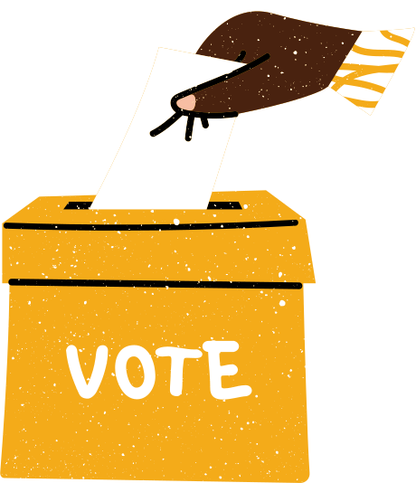
HOW DO I APPLY?
  Talk with your adviser, parents, and school officials
  Decide which office to run for
  Review your application and responsibilities
  Submit application by deadline
WHAT’S NEXT?
  Attend candidate webinar
  Create and submit campaign materials
  Prepare speech and platform
  Select your campaign manager and team
  Campaign at SLC
  Deliver timed speech
  Await election results
Notes:
Running for State Office begins earlier than the State Conference itself. In fact, applications to run for state office are released at the beginning of the year. It is important that you consult with your advisor and have everything approved through your school before starting the process. Next is getting your campaign materials approved by the State Office; that deadline will be released when applications close. Next is the conference itself, where you will campaign for hours on end, canvassing and convincing delegates to support your campaign. Candidates for President and Secretary will deliver their timed speeches in front of all attendees at the opening session on the first day of the conference while District VP candidates will deliver their speeches to their respective district voting delegates on the second day of the conference.

Slide 32
STAY CONNECTED
Notes:
One of our biggest priorities as a State Officer team is to make sure you all feel connected within the state!

Slide 33
2023-2024 State Officer Team Contact Information
Kendi McHargh, State President
Madilyn Hanback, State Secretary
Catherine McWhorter, District 1 VP
Jared White, District 2 VP
Armani Dixon, District 3 VP
Shar'Dajai Harris, District 4 VP
Carson DuBose, District 5 VP
Greyson Sparks, District 6 VP
alfblastatepresident2024@gmail.com
alfblastatesecretary2024@gmail.com
alfbladistrict1vp2024@gmail.com
alfbladistrict2vp2024@gmail.com
alfbladistrict3vp2024@gmail.com
alfbladistrict4vp2024@gmail.com
alfbladistrict5vp2024@gmail.com
alfbladistrict6vp2024@gmail.com
Notes:
Up on the screen are a few ways to make sure you and your chapter stay connected. Be sure you take a picture of this slide with all of the state officer emails.

Slide 34
2023-2024 State Officer Team Contact Information
Ms. Roslyn Evans, State President Adviser
Mrs. Tisha Hanback, State Secretary Adviser
Mrs. Janet Cavender, District 1 VP Adviser
Mrs. Monica Kirkman, District 2 VP Adviser
Mrs. Vicky Crane, District 3 VP Adviser
Ms. Bridget Davis, District 4 VP Adviser
Mr. Gabe Lee, District 5 VP Adviser
Mrs. Stacey Turner, District 6 VP Adviser
Mrs. Lisa Weeks, Alabama FBLA State Adviser
revans@tusc.k12.al.us tisha.hanback@lcschools.org jgcavender@morgank12.org mkirkman@tusc.k12.al.us vcrane@saralandboe.org bridgetdavis@lowndesboe.org gabe.lee@sccboe.org sturner@albertk12.org
lweeks@alsde.edu
Notes:
Here is the contact information for each of our advisers. If you ever have any questions, they’d love to help.

Slide 35
Stay Connected with FBLA!
Alabama FBLA State Website
www.alabamafbla.org
FBLA National Website
www.fbla-pbl.org
Connect with a State Officer!
https://forms.gle/oV2abtaY9ZGtgQPN7
Find us on Facebook, Instagram, and Remind for updates!
Facebook: Alabama FBLA
Instagram: @AlabamaFBLA
Remind: @alfbla2024 to 81010
Notes:
These websites and social media platforms are some of the ways you can learn more about FBLA at the state and national level. Our state website is alabamafbla.org, and our national website is fbla-pbl.org. Both of these sites have great resources regarding chapter management, awards, and more. You can also find us on Facebook and Instagram, and you can join our Alabama FBLA Remind, code @alfbla2024.

Slide 36
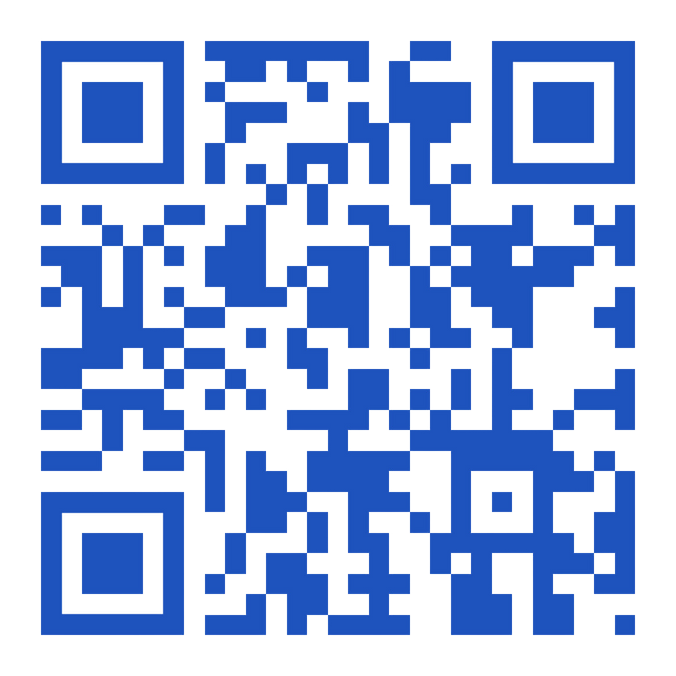
Stay Connected with FBLA!
Connect with a
State Officer for Mentorship!
Notes:
If you are interested in connecting with one of the State Officers for Mentorship, take a picture, or scan this QR code! It will redirect you to a mentor request form. We would love to help you throughout your FBLA journey, and always be available as a resource. Make sure you screenshot or scan to connect with any one of us!

Slide 37
ANY QUESTIONS?
Notes:
We’d now like to open the floor to any questions! If you have any inquiries, feel free to unmute, or type your questions in the chat.

Slide 38
THANK YOU
FOR ATTENDING!
Notes:
If there are no further questions, we would like to say thank you so much for joining us tonight! We are so glad you decided to join and hope you gained more information to prepare for conferences in the future. If you ever have any questions, feel free to contact any member of the State Leadership Team anytime, we would love to stay in touch. We hope to see you utilizing this knowledge at the 2024 State Leadership Conference this April!

