Slide 1
FBLA BINGO
LET'S GET TO KNOW EACH
OTHER BETTER!
Fill up your bingo sheet before we begin the workshop!
The same person can only sign once! Find some new friends!
Notes:
*Officers will be helping chapters sign in and get seated. As members pass, we will mention the FBLA Bingo activity on their tables for them to complete.*

Slide 2
WELCOME!
TO THE ALABAMA FBLA
DISTRICT 6 WORKSHOP
We Are Delighted To Have You Join Us!
Notes:
Hello Alabama FBLA Members and Advisers! My name is Kendi McHargh, I am a Junior at Central High School Tuscaloosa, and I currently serve as your 2023-2024 Alabama FBLA State President. We also have two amazing District Vice Presidents here today, representing Districts 2 and 4.
~
We are so excited and glad to see you all here today at the Alabama FBLA District 2 Workshop! This workshop will provide you with valuable information and skills to help you make the best of this year in FBLA, so we hope you're ready to have fun.

Slide 3
DISTRICT WORKSHOP
SPONSORED BY
Notes:
As we begin this workshop, we would like to thank our sponsor, the Alabama Securities Commission. We greatly appreciate everything they have done for Alabama FBLA,
- and are very excited for the workshop they will present later on, [Sponsor Workshop]!
- and are very excited to hear from their representative later on, [Representative's Name]!

Slide 4
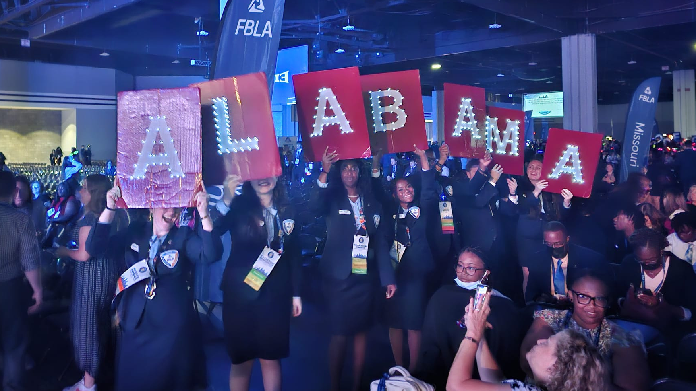
HOUSEKEEPING
Notes:
We have a few housekeeping items to cover. Please remember to clean up after yourselves, and make sure any garbage is put in one of the trash cans around the room. We do ask that you limit cell phone use throughout the workshop. Today, we will be guiding you through fun activities and want you to meet new people and learn how to support your chapter. We will take short breaks between activities, so you can tidy your area, freshen up, and throw away trash. Restrooms are also open outside these doors, to the right. Please stay in this room in order to not disturb others in the building. Thank you!
Mention unique callbacks for noise control.

Slide 5
INTRODUCING: YOUR STATE LEADERSHIP TEAM
2023-2024 Alabama FBLA State Officer Team
Mrs. Lisa Weeks
AL FBLA State Adviser
Notes:
At the 2023 State Leadership Conference, voting delegates elected the 2023-2024 State Leadership Team. The State Leadership Team consists of our State President and Secretary, six District Vice Presidents, eight State Officer Advisers, and our amazing State Adviser, Mrs. Lisa Weeks.

Slide 6
INTRODUCING: YOUR EXECUTIVE OFFICERS
Kendi McHargh
Madilyn Hanback
State President
State Secretary
Notes:
Serving as State President this year is Kendi McHargh from Central High School - Tuscaloosa, and your State Secretary is Madilyn Hanback from Rogers High School in Florence.

Slide 7
INTRODUCING: YOUR DISTRICT VICE PRESIDENTS
Catherine McWhorter
Jared White
Armani Dixon
District I Vice President
District II Vice President
District III Vice President
Notes:
Catherine McWhorter is your District 1 Vice President from Priceville High School, your District 2 Vice President is Jared White from Central High School - Tuscaloosa, and Armani Dixon from Saraland High School is your District 3 Vice President.

Slide 8
INTRODUCING: YOUR DISTRICT VICE PRESIDENTS
Shar'Dajai Harris
Carson DuBose
Greyson Sparks
District IV Vice President
District V Vice President
District VI Vice President
Notes:
Representing District 4 is Shar’Dajai Harris from Lowndes County Career Technical Center, our District 4 Vice President. Your District 5 Vice President is Carson DuBose from Eden Career Technical Center in Asheville, and Greyson Sparks from Albertville High School is your District 6 Vice President.

Slide 9
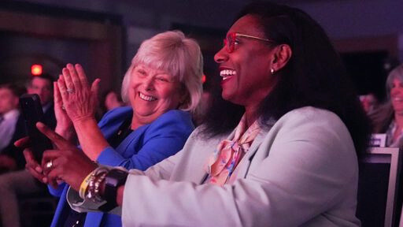
ADVISER BREAKOUT
Notes:
Now, let’s say goodbye and see you later to our wonderful advisers. Advisers, you are now dismissed to go to the adviser workshop that is located in through these doors, and down the hall.

Slide 10
AGENDA
1
5
Conferences & Competitions
Introductions
2
6
Dress Code
Membership
3
7
Awards and Recognition
Chapter Activities
4
March of Dimes
8
Staying Connected
Notes:
Let’s take a look at today’s agenda. We are going to talk about membership, chapter activities, conferences and competitions, dress code, March of Dimes, awards and recognition, and how to stay connected because Together We Achieve!

Slide 11
ICE BREAKER: MIRROR, MIRROR
LET'S GET TO KNOW EACH
OTHER BETTER!
Complete the activity sheets on your table, fill it with everything that makes you, you!
Once completed, share your answers with those around you, get to know your fellow FBLA members!
Notes:
Now, let’s get to know each other better! Find the Mirror, Mirror sheets on your table. Fill them out and then share your answers with the people at your table.

Slide 12
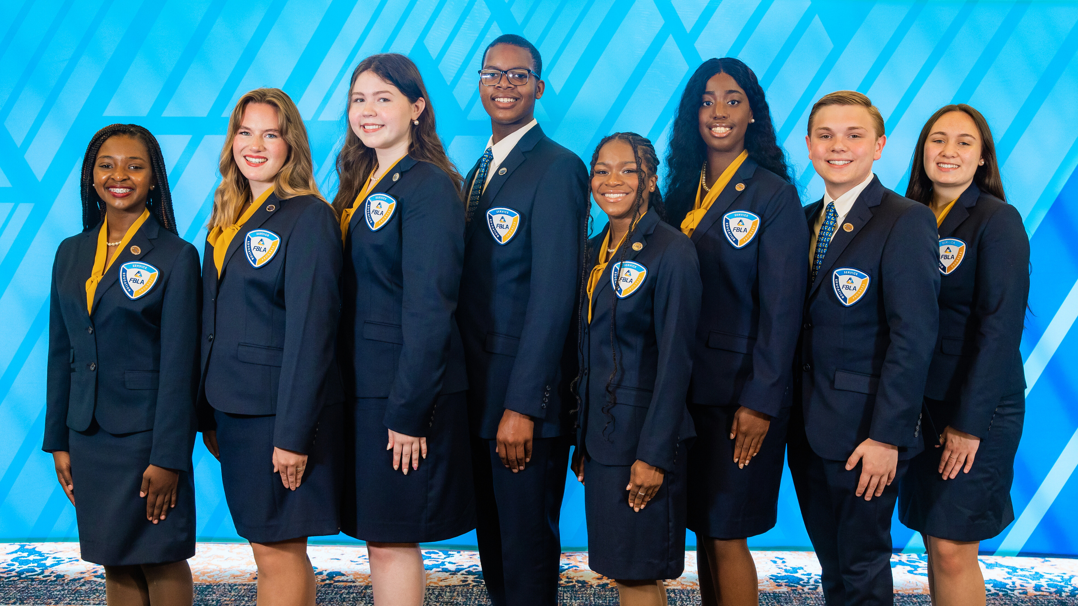
Notes:
(Present your Mirror Mirror sheet)

Slide 13
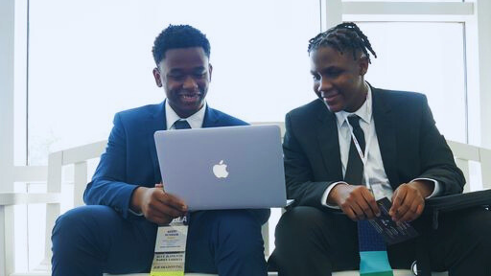
MEMBERSHIP
As an FBLA member, you are setting a strong foundation for your future. From community service opportunities, to educational programs and competitions, FBLA benefits everyone!
Notes:
Now, let’s dive into membership! Who can tell me a major benefit from being an FBLA member? [Crowd participation] Being a member of FBLA is super beneficial because not only are you building your future but you are also giving back to your community and gaining knowledge!

Slide 14
ACTIVE MEMBERSHIP 101
Build a FBLA community
Prepare for your future
Create connections
Strengthen leadership skills
Increase exposure to professional environments
Active Membership Benefits
Notes:
Being an active member of FBLA not only gives you your own community but it also prepares you for your future. You get out of FBLA what you put into it! So, by being an active member you are ensuring yourself the best experience in this organization.

Slide 15
FBLA SCHOLARSHIPS
PARTNER ORGANIZATION SCHOLARSHIPS
ACTIVE MEMBERSHIP 101
Dressed to Impress Scholarship
National Leadership Conference Scholarship
Distinguished Business Leader Scholarship
Alabama FBLA District Foundation Scholarship
Johnson & Wales University
Long Island University
The National Technical Honor Society
Active Membership Benefits
SCHOLARSHIPS
Check out the Awards & Recognition tab on www.fbla-pbl.org for more information on scholarship opportunities through FBLA.
Notes:
Your FBLA experience is amplified by the numerous events open for members to attend, like State and National Conferences. Students have the opportunity to apply for scholarships in order to help reduce the costs for both travel and conference attire. The Dressed to Impress Scholarship provides money for business clothes. This year’s deadline has passed, but be ready to apply next school year! The National Leadership Conference Scholarship awards $500 and free conference registration to members planning to attend NLC. Seniors, be sure to apply for the Alabama FBLA District Foundation Scholarship! Alabama FBLA awards six $1,000 scholarships every year, one per district. FBLA loves to provide opportunities to further your leadership skills and education, even beyond your high school chapter membership. Make sure that you take advantage of the resources FBLA offers!

Slide 16
ACTIVE MEMBERSHIP 101
HOW TO BE AN ACTIVE MEMBER
Run for chapter office!
Engage in community service projects!
Participate in FBLA Programs!
Blueprint for Success, Champion Chapter, BAAs, etc.
Volunteer within your chapter!
Assist in creating the Program of Work!
Notes:
You can be an active member in FBLA by taking action in your community. Volunteering at events hosted by your local FBLA chapter, and completing community service projects are great ways to get involved in your chapter.
Let’s take two minutes at your table to discuss projects your chapter has done. (Give groups time to share with the room).
By participating in any of the FBLA programs, such as FBLA Stock Market Game, FBLA LifeSmarts Competition, Business Achievement Awards, and the Lead Awards, you are not only being an active member but you are also gaining relevant knowledge for your present and future.
Strong, active FBLA members work with their advisors. Advisers always appreciate extra help around the chapter! Next time you see a place you can help, don't shy away from volunteering! They are true superheroes! Help them out with anything you possibly can!
The next step in growing your experience as an FBLA member is running for a chapter office. f you enjoy getting involved in FBLA, running for a chapter officer position is a great way to be more involved in the development of your chapter. Being a local chapter officer is a great way to help out behind the scenes and put in some extra work!

Slide 17
GROWING YOUR LOCAL CHAPTER MEMBERSHIP
Host
school-wide events
Stay active
in your community
Highlight membership benefits
Invite nonmembers to chapter meetings
Connect with your community and alumni members
Run outreach campaigns through email and social media
Share your experience as an FBLA member
Collaborate with other organizations in your school
Sharing and promoting FBLA benefits everyone!
New People =
New Ideas
Notes:
As a member, it's your turn to share the FBLA love with your peers and recruit them to join your local chapter. Sharing and promoting FBLA benefits everyone: the organization, the members, and the community! Recruiting new members is an integral part of FBLA. When you bring in new people, they bring in new and innovative ideas that can make your chapter even better by building community and achieving larger goals. Remember, together, we achieve!
Trying to come up with recruitment ideas can be daunting, so let’s brainstorm some together. (Give time for tables to discuss)
Highlighting membership benefits and sharing your FBLA experience with your friends and classmates can help them see what's in it for them if they join FBLA.

Slide 18
MARKET FBLA
PUT YOUR RECRUITMENT SKILLS TO THE TEST!
Create a 60 second elevator speech for members to join FBLA with your table.
Be prepared to share your speech with the crowd.
Nominate one member to deliver the elevator speech.
Best recruitment elevator speech wins!

Slide 19
SPONSOR WORKSHOP
PRESENTED BY
Notes:
Now, we would like to bring up a representative of our sponsor, __, to present the [Sponsor Workshop]. Thank you once again to our sponsor, and please give them a round of applause!
Thank you so much [Representative’s Name]. Let’s give them another round of applause!
30

Slide 20
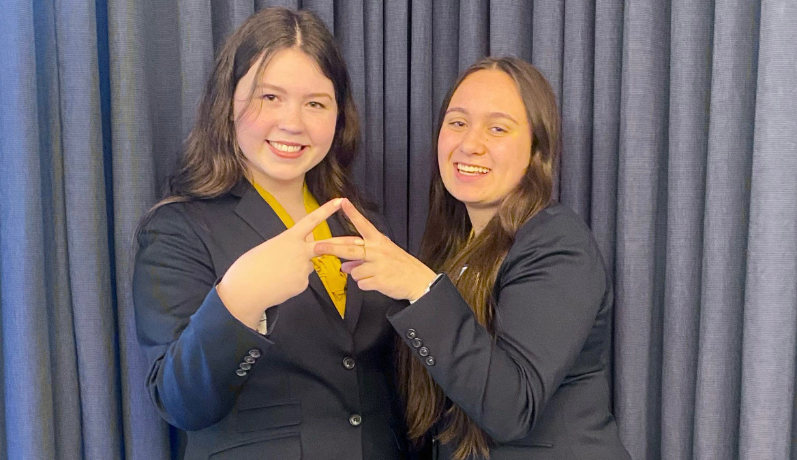
BLUEPRINT FOR SUCCESS
Has your chapter begun the 2023-2024 Alabama FBLA Blueprint for Success?
Notes:
*A couple copies per table*
The Alabama FBLA Blueprint for Success is a series of tasks that can be completed by chapter members and their advisers.

Slide 21
ALL ABOUT THE BLUEPRINT
WHAT IS THE BLUEPRINT?
HOW CAN WE COMPLETE THE BLUEPRINT?
WHAT ARE THE BENEFITS?
A challenge for chapters, that helps raise the activity level, and create an outline for the chapter’s program of work.
Finish all required and at least two optional tasks within each section.
Provide documentation of task completion.
Submit your Blueprint by March 8, 2024.
Recognition at the 2024 Alabama FBLA State Leadership Conference.
Aligns with the FBLA National Champion Chapter and the Middle School Merit Awards.
RIBBONS!
Notes:
By completing the blueprint, chapters gain the ability to engage in multiple activities in their school and community. The blueprint can be completed to receive chapter recognition, and multiple blueprint tasks align with the National FBLA Middle School Merit Award, and National FBLA Champion Chapter tasks for High School. The purpose of these two being together is to increase national recognition and participation. Both must be completed to receive state and national recognition. Remember, your chapter’s blueprint along with task documentation is DUE to the state office no later than March 8, 2024, and it MUST be bound in a three ring binder or spiral notebook.

Slide 22
Blueprint Examples!
Notes:
The Alabama FBLA Blueprint for Success consists of more than 70 optional tasks and 10 required tasks that can be completed. Let’s look through the Blueprint now. If you have any questions, let us know!
For high schoolers, the highlighted tasks are the required tasks which must be completed in order to complete the Blueprint. The Blueprint consists of 5 Sections (Strong Foundation, School Kick-Off, Building Opportunities, Helping Hands, and Celebrating Success), which are organized by recommended timelines. There are 3 levels of the Blueprint. The Achievement Level requires two optional tasks per section, the Excellence Level requires three optional tasks per section, and the Outstanding Level requires five optional tasks per section.
The middle school Blueprint is separated by required and optional tasks, but they can achieve the same levels with the Achievement Level requiring 10 optional tasks, the Excellence level requiring 15 optional tasks, and the Outstanding Level requiring 25 optional tasks.
The completed Blueprint needs to be properly documented in a 3-ring binder or spiral bound. The tasks must be labeled in the right hand corner of each page and be checked off on the copy of the Blueprint to indicate what has been completed.

Slide 23
THE CHAMPION CHAPTER
What is the Champion Chapter?
A series of membership focused challenges for high school chapters, separated into five seasons, and submitted to FBLA National.
How can our chapter complete the challenge?
Your chapter adviser or chapter president will submit all documentation!
Earns your chapter recognition at the 2024 FBLA National Leadership Conference

Slide 24
THE MERIT AWARD
What is the Merit Award?
A series of membership focused challenges for middle school chapters, separated into ten months, and submitted to FBLA National.
How can our chapter complete the challenge?
Your chapter adviser or chapter president will be able to submit all documentation!
Earns your chapter recognition at the 2024 FBLA National Leadership Conference

Slide 25
PLANNING THE YEAR:
THE PROGRAM OF WORK
Chapter activities take tons of planning, the Program of Work makes it easy!
Notes:
The Blueprint for Success is a great guideline to use as members develop their Program of Work for the school year.

Slide 26
THE PROGRAM OF WORK
Program of Work Explained
Program of Work Template
The Program of Work (POW) is a planning outline for chapter activities throughout a school year.
The POW is divided into seven sections:
Program Component
Objective
Action
Target Date
People Involved
Budget
BAA Connection
Remember, FBLA is a student-led organization. So, the creation of the POW is member driven!
Notes:
A program of work is a strategic planning and organizing device your chapter can complete to organize plans for the school year. Developing a Program of Work provides a road map for your chapter and helps all officers, members, and advisers work together to achieve both individual and chapter goals for the year.

Slide 27
THREE STARS AND A WISH
SETTING PERSONAL GOALS IS IMPORTANT TOO!
On the back of your Mirror, Mirror sheet, complete the Three Stars and a Wish activity.
Share your answers with those around you.
Collaborate with one another to come up with a wish for your FBLA chapter!
Notes:
Goal setting is vital for having a successful year in your chapter. Keep in mind that goals are great, but results are better. Start with small goals, then build. Though you may not achieve all of your goals in the set timeline, do NOT stop working on them. Giving up shows you how close you were to finishing, the more you work, the closer you are to reaching those goals.

Slide 28
Let's Learn More About Our Longtime National Fundraising Partner!
Notes:
As many of you know, one of FBLA’s largest missions is the fight for premature babies and their mothers. FBLA has been a fundraising partner with the March of Dimes since 1970 and since then, has been the number one student organization donor to the organization.

Slide 29
WHAT IS THE MARCH OF DIMES?
The March of Dimes is a U.S. non-profit organization.
Founded by President Franklin D. Roosevelt in 1938 to combat polio.
Today it strives to improve the health of mothers and babies.
Notes:
So, what exactly is the March of Dimes?
March of Dimes was originally conceived as the National Foundation for Infantile Paralysis by President Franklin D. Roosevelt in 1938. The name March of Dimes was coined (no pun intended) by comedian Eddie Cantor that same year. Today, the nonprofit strives to improve the health of mothers and babies-- focusing on healthy pregnancy and ending the preterm birth crisis, with innovations like folic acid, newborn screening, and surfactant therapy.

Slide 30
WHY ARE WE INVOLVED?
To give every baby the best possible start.
To encourage policies that support the development of healthy moms and strong babies.
Notes:
The March of Dimes is an organization that does wonderful work worldwide.
As FBLA members, we advocate for safe and equal communities. This includes fighting for the most vulnerable and at risk people in our communities, babies.
I would like to ask- how many of you know someone who was born premature? Or, maybe you were born premature?
Just think about this… 13% of babies born in the State of Alabama are born preterm. That is the second highest preterm birth rate in this country. And according to the March of Dimes, that number is only growing. A major problem currently is equal access to healthcare, that is so needed for these babies to survive.
We are involved because we want to help an organization that works to give every baby the best possible start, and to encourage policies that support the development of healthy moms and strong babies.

Slide 31
THIS YEAR'S FUNDRAISING GOAL IS...
$82,500
Notes:
For those of you who attended SLC and NLC , you all may know that our state chapter raised just short of $100,000, shattering the previous year’s fundraising total. Alabama FBLA was recognized at the National Leadership Conference for being the top FBLA State Chapter donor for the March of Dimes. We are proud to have been the top fundraiser for the past decade raising nearly $1,000,000 for this incredible organization! This year's state fundraising goal is $82,500, which is only possible through the help of your local chapter fundraising.

Slide 32
WHAT CAN YOU DO?
Community Fundraiser
Blue Jeans for Babies
Mini Walk
Donation Bucket
Tailgate
T-Shirt Sales
Town, School, Class
Pennies to $20s
Notes:
There are ample amounts of material and information for you to assist with March of Dimes fundraising efforts. If your school is hosting an event, such as a football game, you can do a tailgating fundraiser. Selling Blue Jeans for Babies T-Shirts is perhaps one of the best fundraisers your chapter can do. Did any of the chapters here complete this fundraiser this September?
For those unfamiliar, chapter members sell March of Dimes designed shirts to community members, local businesses, and more to obtain donations and gain recognition for the March of Dimes Mission. Not only will you look stylish, but your effort will help countless numbers of little babies across the state.
Some other ideas include hosting can also host a Mini March for Babies, and finally, the all important Mission Moment. There are plenty of great ideas to set up mission moments, perhaps at sporting events have teams compete against each other, or having classes compete against each other at a pep rally.

Slide 33
MISSION MOMENT
Coffee Stirrer
Teaspoon
Paper Clip
Notes:
We will now hold our very own Mission Moment. If you all have some change or a few dollar bills, please join us in donating to the March of Dimes whenever the bucket comes around to you.
Just imagine breathing through this tiny straw 24
hours a day. That’s what it is like for a premature baby
born with underdeveloped lungs.
Imagine a baby born so small that all the blood they
need for a blood transfusion fits within a teaspoon.
A premature baby’s foot is about as large
as this paper clip.

Slide 34
MISSION MOMENT
Bandage
Premature Diaper
Ring
Notes:
A small bandage is the size of a blood pressure cuff for a premature baby.
Just imagine being born so early that this is the size
of your first diaper. Even a diaper this size, large enough to fit within one adult hand, is too big for many premature babies.
Imagine a baby born so small and fragile that this
ring slips easily around the baby’s arm or leg.

Slide 35
Mission
Moment
Notes:
Thank you all for participating. Any contribution can make a difference in the fight for premature babies. With that, we will now watch a video from the March of Dimes, the Wilton's Family Story.

Slide 36
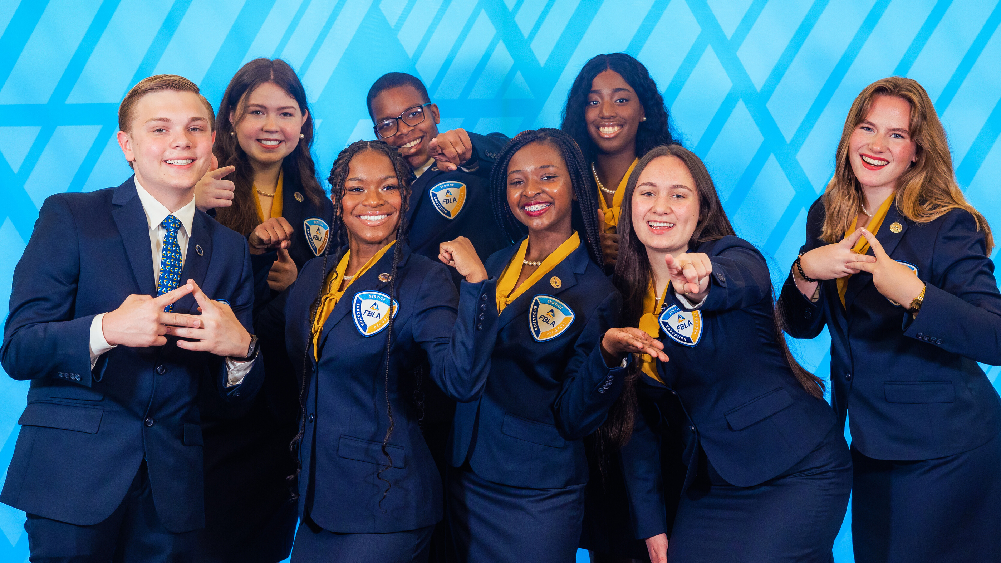
CONFERENCES
Notes:
We’d like to highlight the ultimate FBLA experience– Conferences! Conferences are large gatherings of like-minded students from around our state, nation, and world– from this District Workshop, bringing together FBLA members from your area, to the FBLA National Leadership Conference, gathering thousands of members from Alabama, California, and New York to Puerto Rico, China, and Tanzania!

Slide 37
FBLA CONFERENCES
Academy of Chapter Excellence
Joint Leadership
Development Conference
District Workshops
Notes:
September marks the first conference in Alabama for FBLA members, the Alabama CTSO Academy of Chapter Excellence. We had an amazing time meeting chapter officers from around the state, and hope you can join the fun again next year! The Joint Leadership Development Conference, aka JLDC, is a leadership development conference for students in all CTSOs in the state of Alabama. Which of you walked the red carpet at this year’s events in Mobile or Huntsville? What was your favorite part?
And, finally, here we are today at Alabama FBLA District Workshop!

Slide 38
FBLA CONFERENCES
National Fall
Leadership Conference
State Leadership
Conference
National Leadership
Conference
Notes:
It’s time to get excited for our upcoming FBLA conferences! The National Fall Leadership Conference will kick off in Providence, Rhode Island on November 10, and the Alabama FBLA State Officers hope to see you attending an NFLC, where you will get to meet members from different states, participate in engaging workshops, and explore a new city with your chapter! After that, in April, is Alabama FBLA’s largest gathering, the Alabama FBLA State Leadership Conference! Filled with great workshops, networking opportunities, and competitive events, the SLC truly has it all! Finally, to finish off the membership year, there is the FBLA National Leadership Conference, a super fun, educational, and exciting conference for FBLA members from around the world. We hope to see you and your chapter attending any of these conferences!

Slide 39
COMPETITIVE EVENTS
With multiple events for both middle and high school members, there is a competition for everyone!
Notes:
Let's talk about competitive events. There are many different opportunities for middle and high school level members to compete and find an event which interests them. When deciding what you want to compete in you can also choose to work with friends and do an event with them.

Slide 40
FBLA COMPETITIVE EVENTS
WHAT ARE THE TYPES OF COMPETITIVE EVENTS?
Competitive events are opportunities for FBLA members to showcase their talents and skills related to business and leadership.
Middle School
High School
WHERE DO I FIND COMPETITIVE EVENT RESOURCES?
Internet
Textbooks
YouTube
National Website
FBLA Alumni
Social Media
Previous Competitors
WHY SHOULD I COMPETE?
To network with members with similar interests.
To meet business professionals.
To test your knowledge and skills.
To represent your school.
Students compete for an opportunity to advance to the FBLA National Leadership Conference!
Competitive opportunities for FBLA members to showcase their talents and skills related to business and leadership.
Notes:
Competitive Events allow our members to showcase their leadership and business skills they have learned from FBLA. There are five different competitive event categories for students to choose events from based on their strengths and interests. The five different competitive event categories are Role Play Events, Objective Tests, Presentation Events, Production Tests, and Chapter Events. Competing allows you to test your skills and meet other members from different chapters to talk about your similar interests. Let’s explore how to access information on your competitive events choices now!

Slide 41
EVENT RESEARCH
FIND YOUR EVENT!
Search "FBLA High/Middle School Competitive Events," and complete the 2023-2024 FBLA High/Middle School Event Quiz
Check out the FBLA Competitive Events At-A Glance, Preparation Resources, and Rating Sheets within your division!
Middle School
High School
Notes:
If you are having trouble picking an event to compete in you can click "FBLA High/Middle School Competitive Events," and complete the 2023-2024 FBLA High/Middle School Event Quiz. This allows you to find the perfect competitive event for you!

Slide 42
DRESS CODE
Notes:
Now let's talk about another important aspect of conference and competition: dress code.

Slide 43
FBLA DRESS CODE
National Guidelines
1
What is the dress code?
2
Why is the FBLA dress code important?
3
Where can you find appropriate clothing?
Notes:
*LINK TO DRESS CODE*
FBLA has an official dress code which helps our members project a professional image for business leaders while we are at conferences. Professional attire is required for general sessions, competitive events, workshops, etc. Some examples of business attire will be a Business Suit(Suit Pants and a Jacket), a Blazer( Dress Pants/Skirt and a Blazer), and a Business Dress with dress shoes. Some examples of what not to wear would be Denim, Leggings, Athletic Shoes, Swimwear, Revealing Clothes, and Hats.

Slide 44
AWARDS &
RECOGNITION
Notes:
Awards are one of the things everyone looks forward to at SLC and NLC. Let's talk about how to receive awards and recognition!

Slide 45
WAYS TO EARN RECOGNITION AT SLC & NLC?
High School
BAA
Champion Chapter
Blueprint for Success
Competitive Events
March of Dimes
Gold Seal Chapter
Chapter of Distinction
Who’s Who?
Middle School
LEAD Awards
Merit Awards
Blueprint for Success
Competitive Events
Chapter Distinction
Gold Seal Chapter
Young Leader Award
Notes:
For national recognition, high school chapters can participate in the BAA and Champion Chapter. BAA stands for Business Achievement Awards. There are four different levels for BAA: the contributor, the leader, the advocate, and the capstone level. For each level completed, you receive an award. Champion Chapter is a nationwide recognition program that has four different sections. During each section, there is a different focus point. The more tasks you do the more points you receive, which boosts your recognition award level. Blueprint for Success is a state-wide recognition program. It is provided to track chapter operations and engagement. Blueprint for Success is made to correlate with the Champion Chapter, meaning the more you do on Blueprint, the more you can do on the Champion Chapter. Competitive Events are open to both high school and middle school levels. Competitive Events start at state-level and provide you with an opportunity to compete nationally. To get recognized for the March Of Dimes, you have to fundraise! March Of Dimes awards are based on how much money your chapter raises or donates throughout the FBLA year! All of the above programs give you a chance to become a Gold Seal Chapter. To become a Gold Seal Chapter, you have to be active and participate a lot in state and national programs!

Slide 46
BE ICONIC ACTIVITY
Notes:
Everyone in their way is Iconic. Let’s describe just how iconic you are! On your table, there should be a notecard or a rectangular sheet of paper, grab it and write your first name and grade level, it is big and decorative in the middle! On the top left of the paper, draw an animal that represents your personality or a trait that you possess. Next, on the top right, draw the type of environment you enjoy the most. For example, the outdoors, indoors, city, or in the country. Now on the bottom left, draw a no symbol with something you do not enjoy, like, or want in your future, or something you’re afraid of. Lastly on the bottom right, draw something representing one of your future goals. Once you’re done with it, feel free to share it with your table!

Slide 47
Notes:
Alright guys it is time to take a brain break and get up and dance to Just Dance “Can’t Stop The Feeling”. Let's get the blood and mind flowing for more fun information to come.

Slide 48
How Do I Become A State Officer?
Positions Available:
1
1
6
President
Secretary
District Vice President
Notes:
That was fun! Now it’s time to talk about How to Become A State Officer. There are three different positions available for application. The first position is President. The president presides over and conducts meetings, keeps members and discussions on track, appoints committees, serves as a delegate at NLC, coordinates chapter activities by keeping in touch with officers, and so much more. The secretary prepares and reads the minutes of each meeting, serves as a delegate at NLC, assists the president, sends out reminder notices, prepares reports, and keeps in touch with chapters. The vice president assists the president, keeps in touch with districts, hosts district meetings, and encourages participation.

Slide 49
How Do I Become A State Officer?
Application Process:
Complete the state officer application.
100-word essay: “Why I want to be a state officer”
Notes:
Next is the application process. The beginning of this process is to fill out the state officer application. After that, you will have to write a 100-word essay about, “Why I Want To Become A State Officer.”
All applications should be typed and not handwritten

Slide 50
How Do I Become a State Officer?
Campaign Process:
Campaign at on-site campaign booths at SLC
Give campaign speech
Officer Duties:
Attend officer training and conferences
Develop State POW and Blueprint
Host District Workshops
Assist at conferences
Chapter visits
Communicate with members and advisers
Officer Specific Duties:
President: Prepares agendas and leads all meetings
Secretary: Takes minutes at all meetings
District VP: Maintain Districts
Notes:
There are a few steps to becoming a state officer after you fill out the state officer application and complete the essay you will start preparing your campaign materials for the state conference. At the conference, you will have your booth set up where all the voting delegates will come through and learn more about you and why you would make the best fit for that officer position. You and your campaign manager will then give a speech in front of your district or on the main stage depending on what position you are running for. After you are elected it's time to start preparing for the school year. You will start off your journey by attending state officer training where you will learn all the ins and outs of being a state officer. This is where you and the rest of the state officer team will work alongside the advisor community to complete the program of work and blueprint. As a state officer, you will be expected to hold conferences and attend chapter visits as well as keep in touch with the chapters in your district. If you decide to run for President you will be expected to lead all of our meetings that the state secretary will be taking the minutes for. All of our district Vice Presidents will be expected to maintain their districts and keep a line of communication open for all members and advisors.
***Campaigning can only take place during campaign hours at the conference and not online or through social media***

Slide 51
CONTACT INFORMATION
FEEL FREE TO REACH OUT TO US ANYTIME!
Notes:
As state officers our goal is to make sure all of our members feel as connected to us as possible so we want you all to know we are more than happy to answer any questions or concerns you have. Please feel free to reach us at any of our emails which will be on the next slide.

Slide 52
2023-2024 State Officer Team Contact Information
Kendi McHargh, State President
Madilyn Hanback, State Secretary
Catherine McWhorter, District 1 VP
Jared White, District 2 VP
Armani Dixon, District 3 VP
Shar'Dajai Harris, District 4 VP
Carson DuBose, District 5 VP
Greyson Sparks, District 6 VP
alfblastatepresident2024@gmail.com
alfblastatesecretary2024@gmail.com
alfbladistrict1vp2024@gmail.com
alfbladistrict2vp2024@gmail.com
alfbladistrict3vp2024@gmail.com
alfbladistrict4vp2024@gmail.com
alfbladistrict5vp2024@gmail.com
alfbladistrict6vp2024@gmail.com
Notes:
These are the emails for all of your 2023-2024 state officer teams. Feel free to write these emails down or take a picture of the screen.

Slide 53
2023-2024 State Officer Team Adviser Contact Information
Roslyn Evans, State President Adviser
Tisha Hanback, State Secretary Adviser
Janet Cavender, District 1 VP Adviser
Monica Kirkman, District 2 VP Adviser
Vicky Crane, District 3 VP Adviser
Bridget Davis, District 4 VP Adviser
Gabe Lee, District 5 VP Adviser
Stacey Turner, District 6 VP Adviser
revans@tusc.k12.al.us tisha.hanback@lcschools.org
jgcavender@morgank12.org
mkirkman@tusc.k12.al.us
vcrane@saralandboe.org
bridgetdavis@lowndesboe.org
gabe.lee@sccboe.org
sturner@albertk12.org
Notes:
These are the emails for all of your 2023-2024 state officer advisor team. Feel free to write these emails down or take a picture of the screen as well.

Slide 54
LETTER TO SELF
WE ARE FUTURE LEADERS
Use the paper, markers, and pens on your table to write a letter to your future self.
This letter is just for you. Include what you want your future self to read!
Tips for Writing
Set goals for yourself between now and when you read this letter.
Add details about your life!
DEAR FUTURE ME...
Notes:
Now it is time for one more activity before we go. On your table, you should see markers, pens, and paper. Go ahead and grab a piece of paper and a marker to write with. You will now begin to write a letter to your future self. You can add goals you want to achieve or just explain what you are doing right now in this season of your life. These will be given back to all advisors at the state conference. So let’s take a few minutes and write those dear future self letters.
*Fold and put name and chapter*

Slide 55
STAY CONNECTED WITH FBLA!
Find us on Facebook, Instagram, and Remind for Alabama FBLA updates!
Facebook: Alabama FBLA
Instagram: @AlabamaFBLA
Remind: text @alfbla2024 to 81010
Alabama FBLA State Website
www.alabamafbla.org
FBLA National Website
www.fbla-pbl.org
5
3
6
Notes:
Our biggest priority as a State Officer team is to make sure you all feel connected up on the screen are a few ways to make sure you and your chapter stay connected. We have a few different choices so feel free to take a picture of the screen and make sure you follow us on all of our social media for updates and reminders.

Slide 56
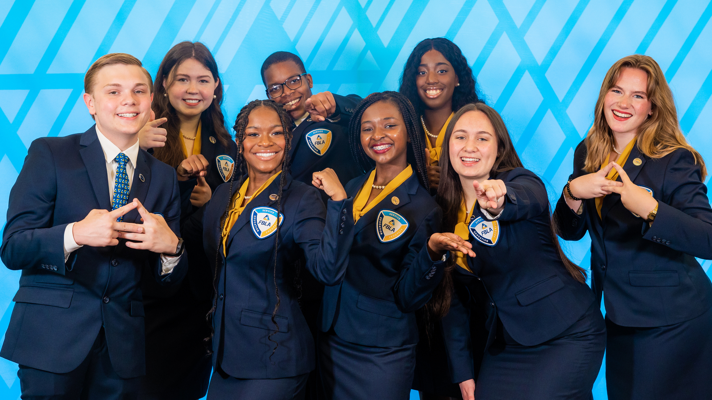
HOUSEKEEPING
Notes:
We have a few housekeeping items to cover. Please remember to clean up after yourselves, and make sure any garbage is put in the trash cans [Location]. We do ask that you limit cell phone use throughout the workshop. Today we will be guiding you through fun activities and want you to meet new people and learn how to support your chapter. We will take short breaks between activities, so you can tidy your area, freshen up, and throw away trash. Restrooms are also open at [Location]. Please stay in this room in order to not disturb others in the building. Thank you!
Mention unique callbacks for noise control.

Slide 57
TH NK YOU!
TH NK YOU!
For Attending
TH NK YOU!
TH NK YOU!
Notes:
Now we would just like to say thank you so much for attending the 2023 district (#) workshop! We are so glad to see you all in person and can not wait to see you at the state conference in April!

