Slide 1
Competitive Events
Future Business Leaders of America
2023-2024

Slide 2
2
Webinar Overview
Webinar will be recorded
Recording will be available online
Chat and audio are disabled
Use the Q&A feature to ask questions
Future Business Leaders of America

Slide 3
3
Webinar Overview
CEC
Categories
Guidelines
Resources
Changes
FAQ/Best Practices
Future Business Leaders of America

Slide 4
4
DISCLAIMER
Information covered is about NATIONAL Competitive Events.
Ask your state leadership for state-specific information.
Future Business Leaders of America

Slide 5
5
Competitive Events
Competitive events at the National Leadership Conference play an integral role in the mission of FBLA. They prepare students for successful careers in business by providing opportunities to apply classroom concepts in a workforce-simulated competitive environment.
Future Business Leaders of America

Slide 6
6
National Competitive Events Committee (CEC)
Develop & maintain the long-term vision
Review event proposals and make recommendations for additions/changes
Develop, write, & edit guidelines
Review content, focus, & procedures
Develop yearly topics
Conduct workshops
Provide general oversight & management at NLC
Rule on eligibility & procedural concerns at NLC
Future Business Leaders of America

Slide 7
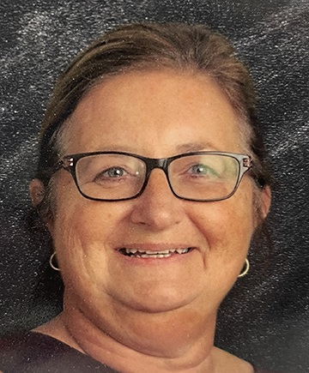
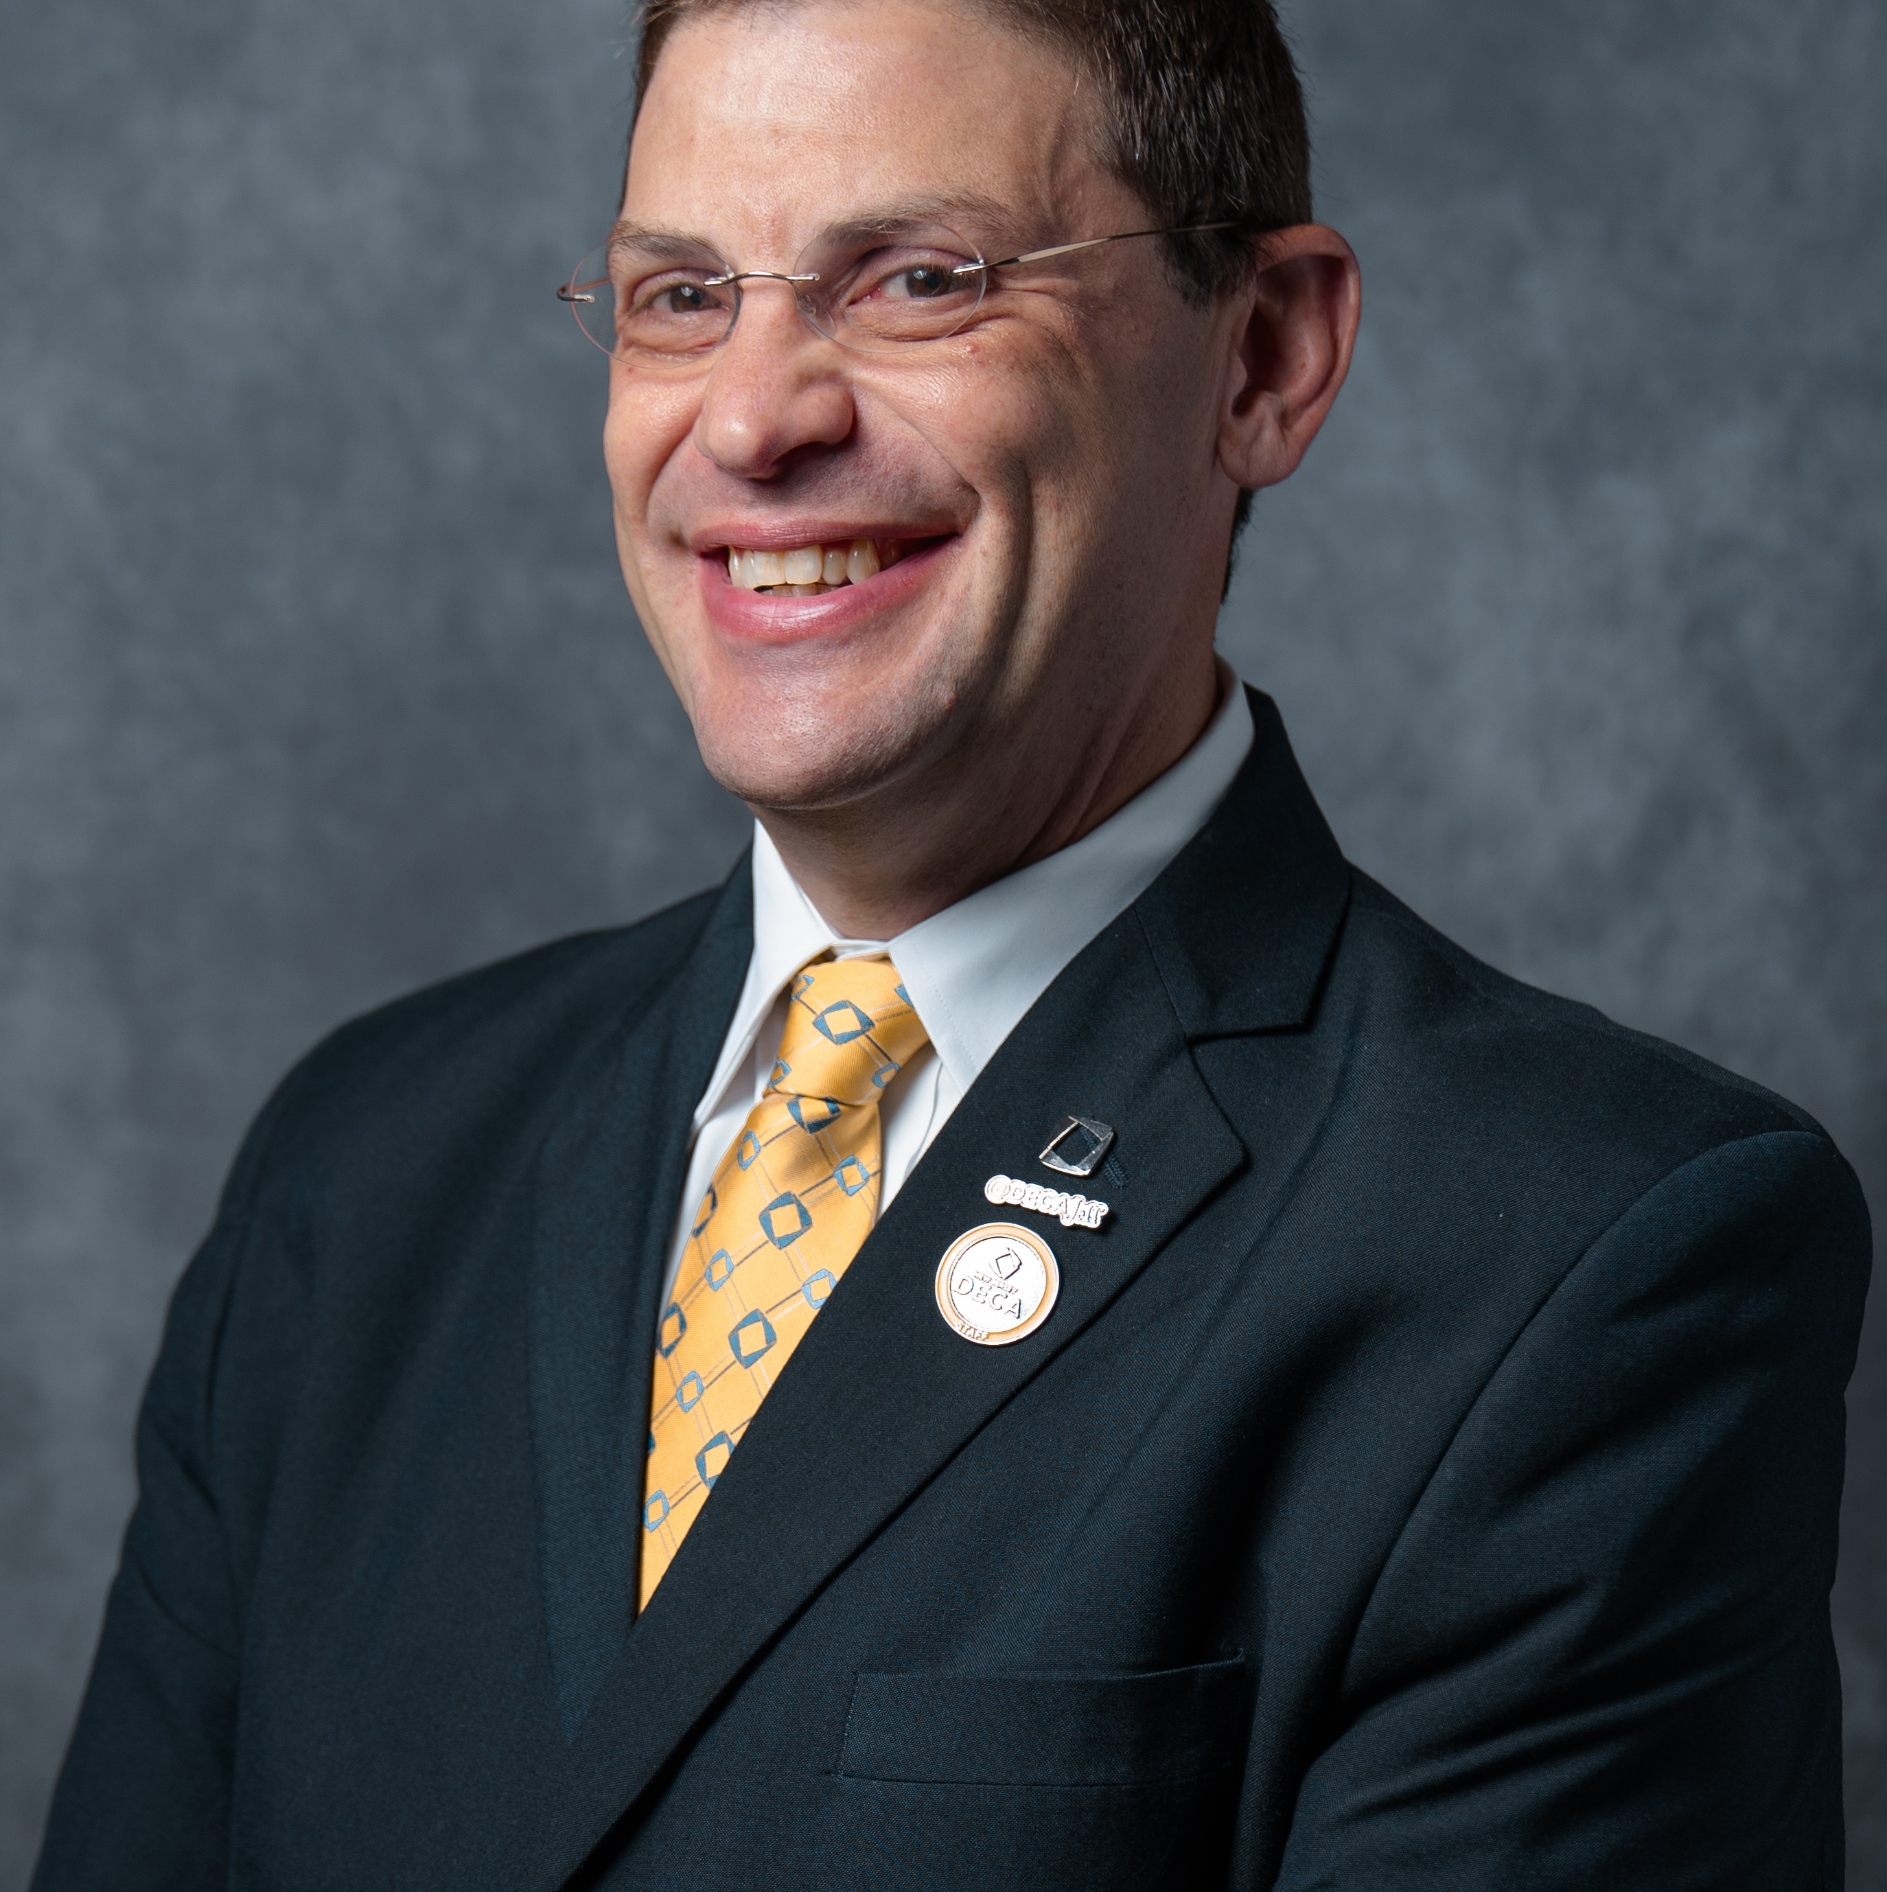
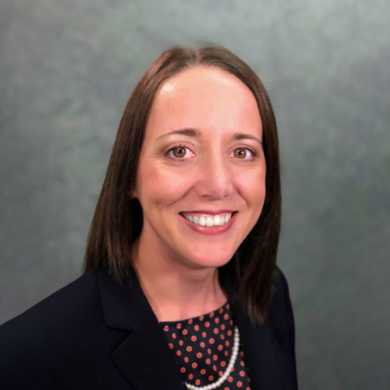
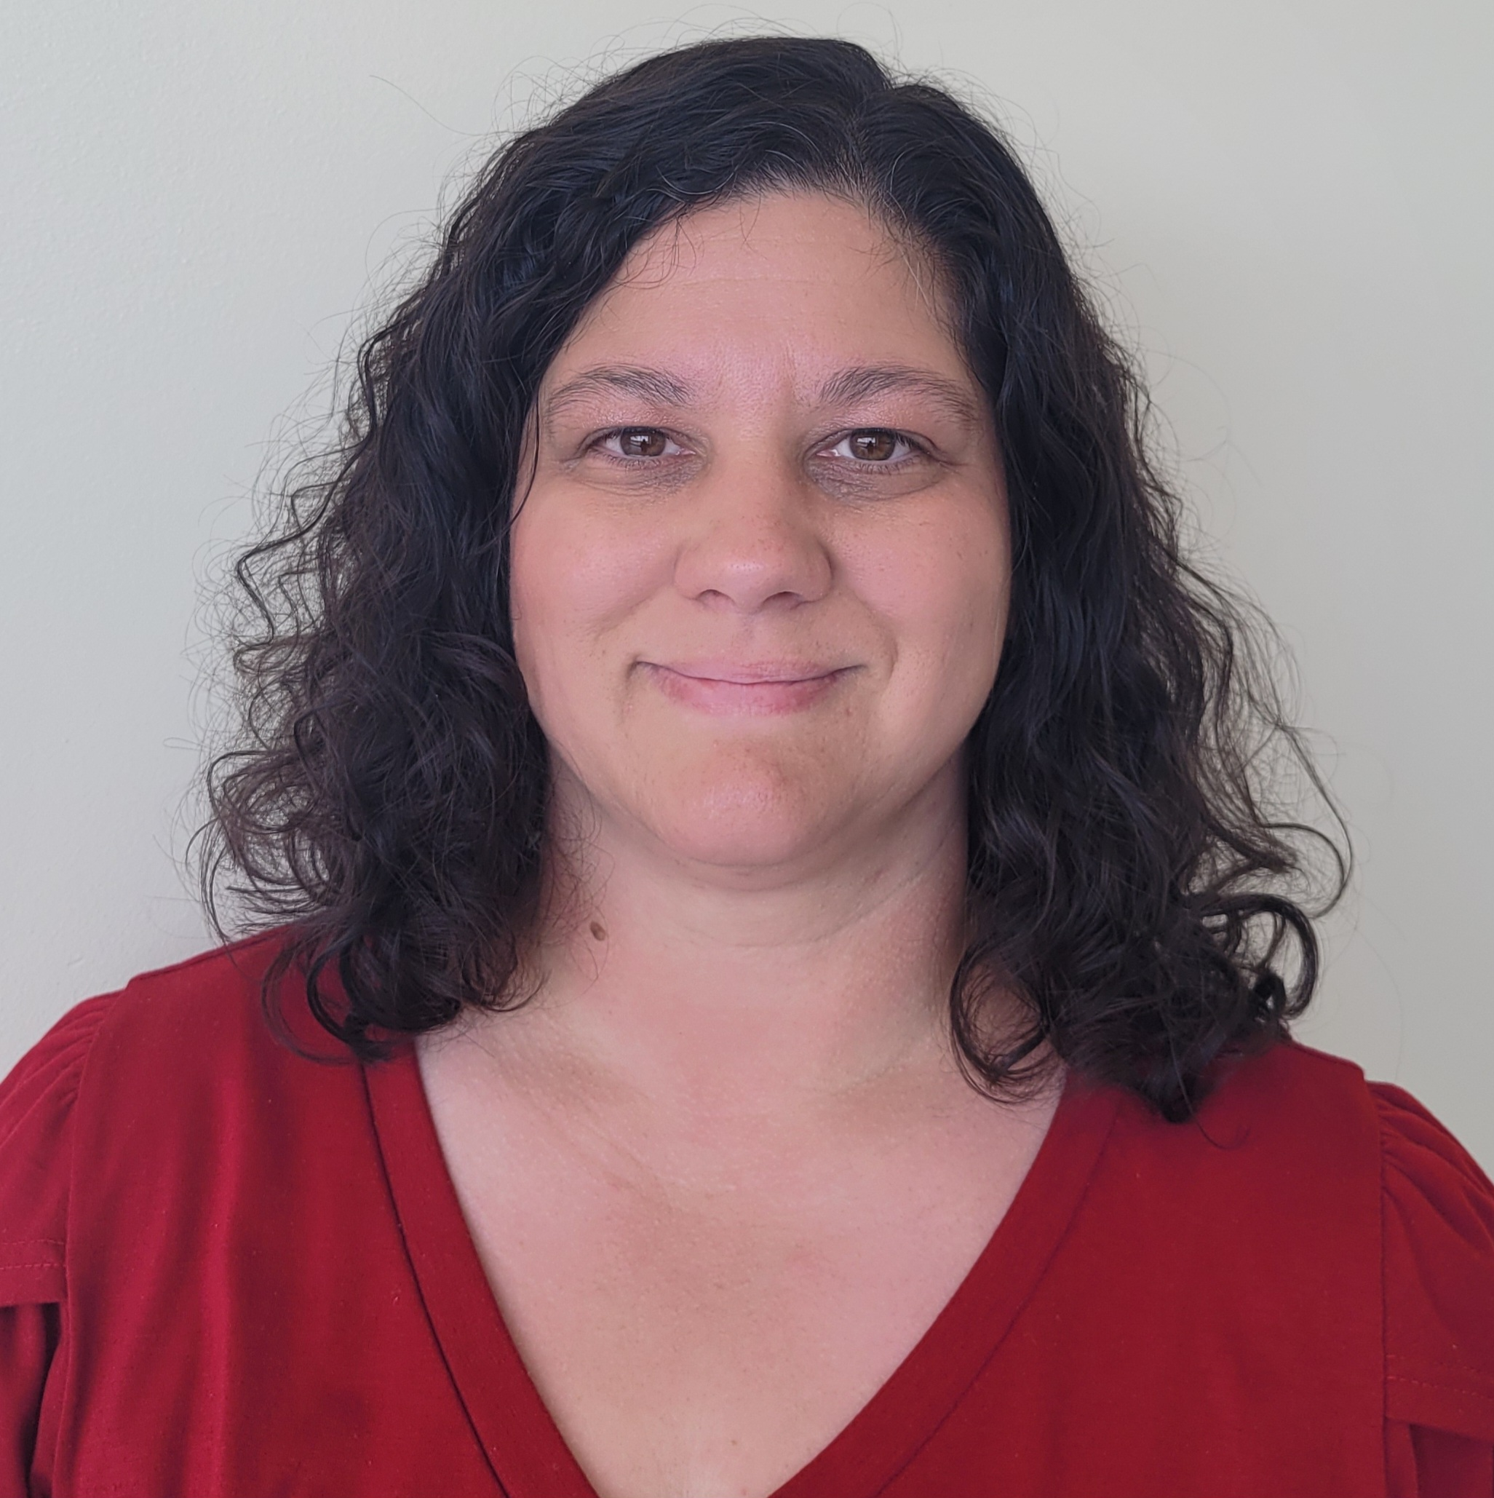
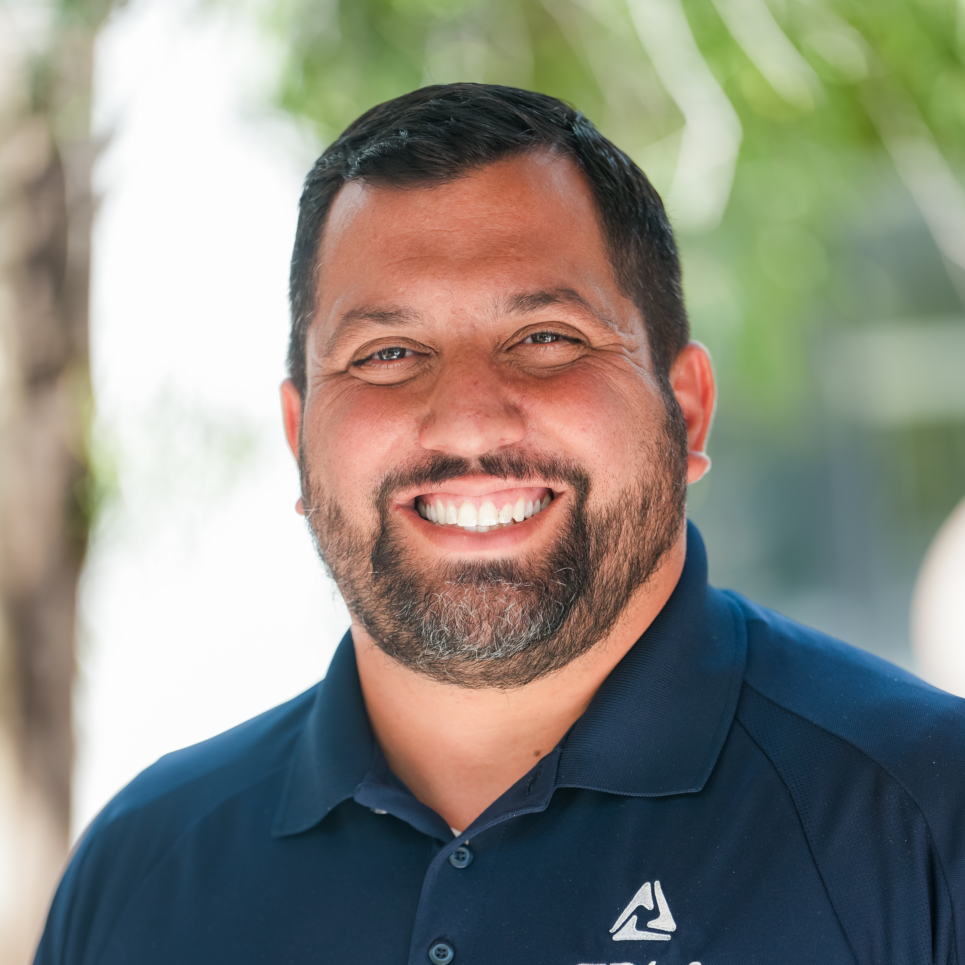
7
Denise Losh (WV)
Jeff Victor (NJ)
Jacqui Garrison (NE)
Chair
Future Business Leaders of America – High School CEC
Jamie Connor (MD)
Vice Chair
Jacob Avila (CA)

Slide 8
8
National Competitive Event Numbers
136 Competitive Events
23 Middle School
77 High School
36 Collegiate
Future Business Leaders of America
NATIONAL Competitive Events Information – Check with State Leader for state-specific information.

Slide 9
9
National Competitive Event Numbers
77 High School Events
4 Chapter Events
29 Objective Tests
27 Presentation Events
4 Production Events
13 Role Play Events
Future Business Leaders of America
NATIONAL Competitive Events Information – Check with State Leader for state-specific information.

Slide 10
10
Categories
Chapter Events
Objective Tests
Presentation
Production
Role Play
Future Business Leaders of America
NATIONAL Competitive Events Information – Check with State Leader for state-specific information.

Slide 11
11
Categories
Chapter Events
A chapter project that a team of students presents
Objective Tests
An online objective test administered at the conference focusing on business knowledge
Future Business Leaders of America
NATIONAL Competitive Events Information – Check with State Leader for state-specific information.

Slide 12
12
Categories
Presentation
The presentation of a project, speech, or interview in front of judges. Competitors may be allowed to use technology, equipment and/or visual aids as a part of the presentation. Check specific guidelines to determine what is allowed.
Future Business Leaders of America
NATIONAL Competitive Events Information – Check with State Leader for state-specific information.

Slide 13
13
Categories
Production
Two parts: A hands-on part focusing on technical skills and an online objective test focusing on technical and business knowledge.
Future Business Leaders of America
NATIONAL Competitive Events Information – Check with State Leader for state-specific information.

Slide 14
14
Categories
Role Play
Two parts: First round is an online objective test administered in conjunction with the conference focusing on business knowledge. The top 15 individuals/teams advance to round two, consisting of an extemporaneous response to a prompt. Judges will interact with competitors.
Future Business Leaders of America

Slide 15
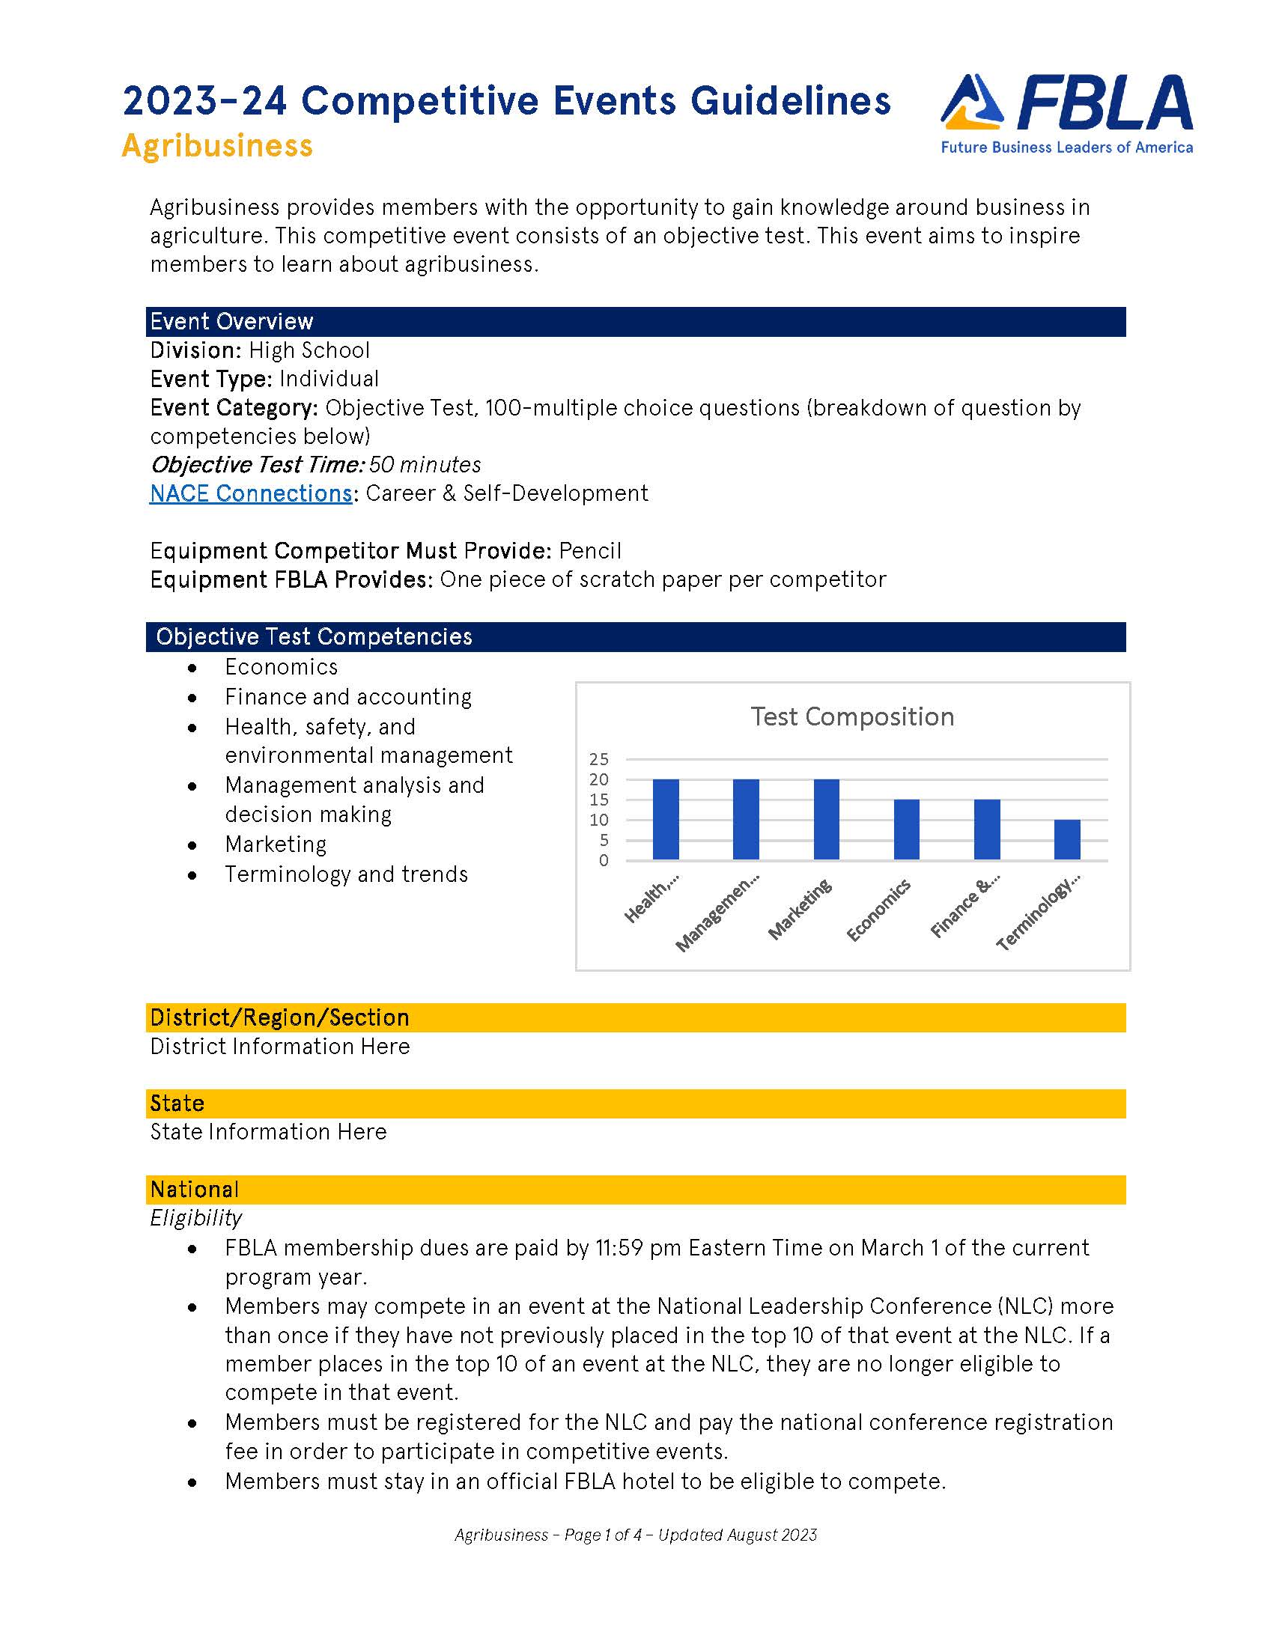
15
Guidelines & Resources
Guidelines are your FRIEND
Let’s take a look…
www.fbla.org
Future Business Leaders of America
NATIONAL Competitive Events Information – Check with State Leader for state-specific information.

Slide 16
16
Changes for All Divisions
Categories
Team – can be individual
Rating Sheet Updates
Ranges
Removed tie breaker column
Penalty Points
Timing Updates
Testing Time (Tie Breaker)
Set-up Time
Presentation Times
Future Business Leaders of America
NATIONAL Competitive Events Information – Check with State Leader for state-specific information.

Slide 17
17
Changes for High School
RETIRED: Business Financial Plan
RETIRED: E-Business
MODIFICATION: Political Science -> Public Policy & Advocacy
MODIFICATION: Publication Design -> Visual Design
NEW: Financial Statement Analysis
NEW: Future Business Educator
NEW: Introduction to Programming
NEW: Website Coding & Development
Future Business Leaders of America
NATIONAL Competitive Events Information – Check with State Leader for state-specific information.

Slide 18
18
Highlighted Changes for Individual Events
Future Business Leader/Job Interview
Resume & Cover Letter brought to competition, but not left with judges
Impromptu Speaking
Presentation time = 5 minutes
Intro to Public Speaking
Presentation time = 5 minutes
PSA
Presentation time = 7 minutes
Future Business Leaders of America
NATIONAL Competitive Events Information – Check with State Leader for state-specific information.

Slide 19
19
Recognition
Top Ten
Recognition on stage
Receive recognition item
Recognition in Tomorrow’s Business Leader
Top Three
Cash Prizes
Future Business Leaders of America
NATIONAL Competitive Events Information – Check with State Leader for state-specific information.

Slide 20
20
FAQs
Repeat Competitors
What’s on the test?
How do I choose events?
How do I prepare for events?
How do I cite my sources?
Future Business Leaders of America
NATIONAL Competitive Events Information – Check with State Leader for state-specific information.

Slide 21
21
Best Practices
Testing = Study the Competencies
Presentations = Practice, Practice, Practice
Use Advisory Committee/Business & Industry Contacts
Plan B for Technology
Implement Into Classroom
Presentations = Rating Sheets are Key
Future Business Leaders of America
NATIONAL Competitive Events Information – Check with State Leader for state-specific information.

Slide 22
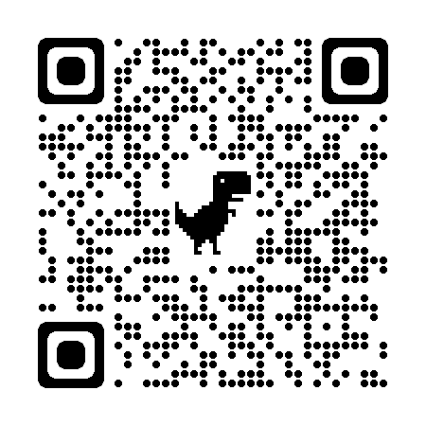
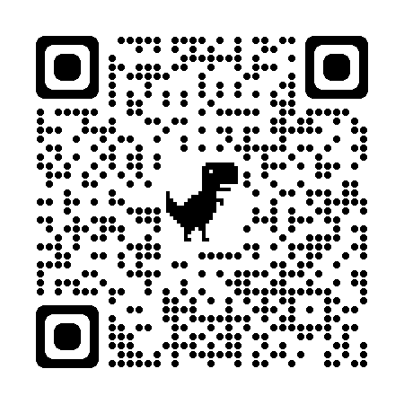

Slide 23
Competitive Events
Jen Staley
jstaley@fbla.org
Future Business Leaders of America
2023-2024

