Slide 1


Alabama FBLA
JULY 27, 2023

Slide 2

Today's Topics
  State Officers
  State and National Website
  Membership, Demographics, etc.
  Upcoming Events and Conferences
  Blueprint for Success
  Chapter Resources
  Chapter Awards
  Dress Code
  March of Dimes
  Staying Connected

Slide 3
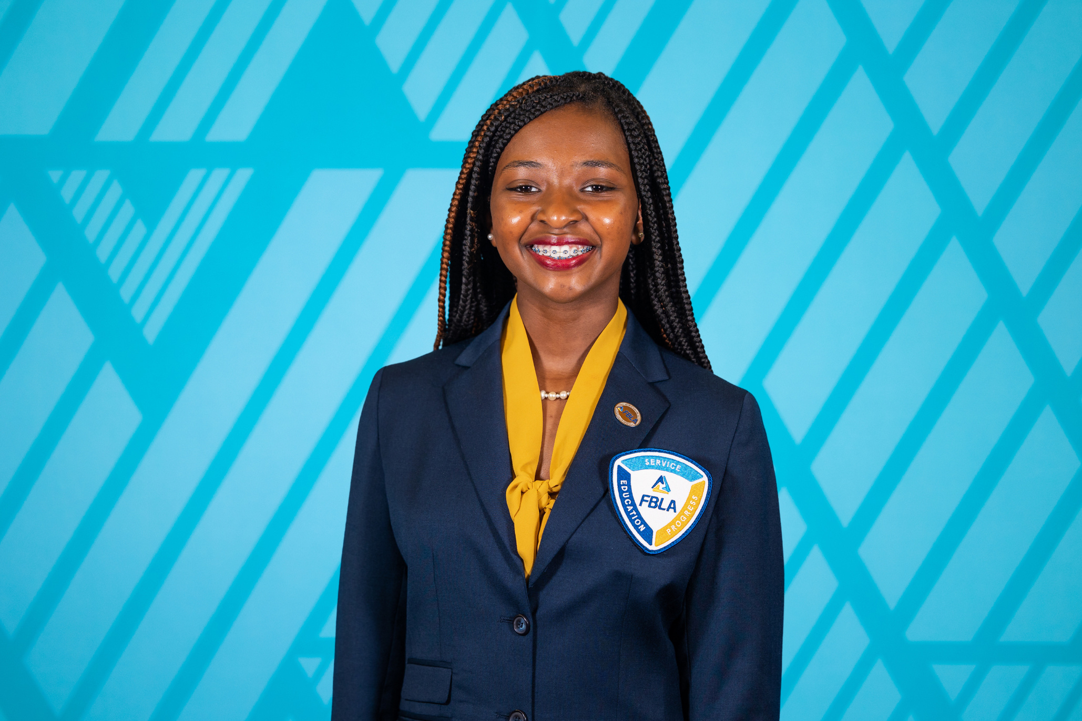
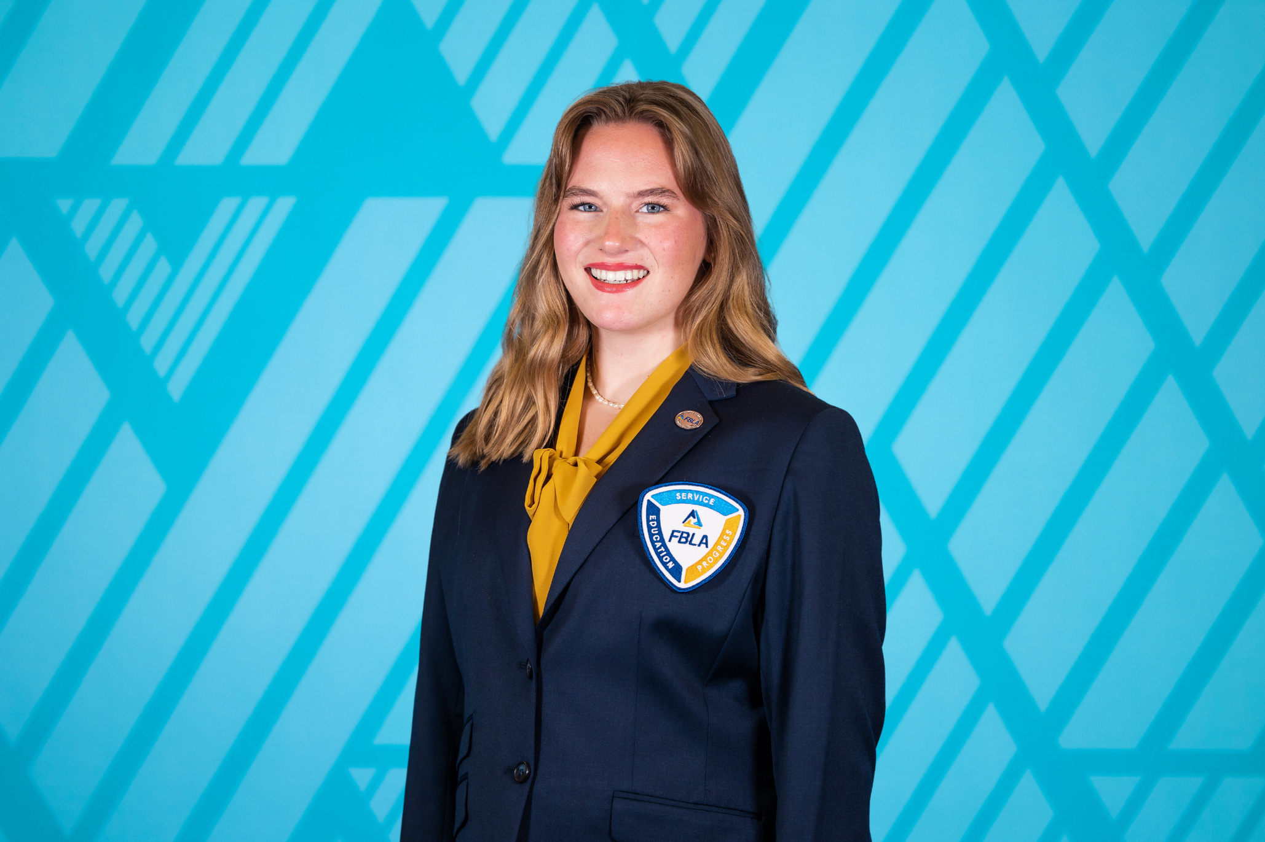
The State Officer Team
State President
Kendi McHargh
Central High School, Tuscaloosa
Adviser: Roslyn Evans
State Secretary
Madilyn Hanback
Rogers High School
Adviser: Tisha Hanback

Slide 4
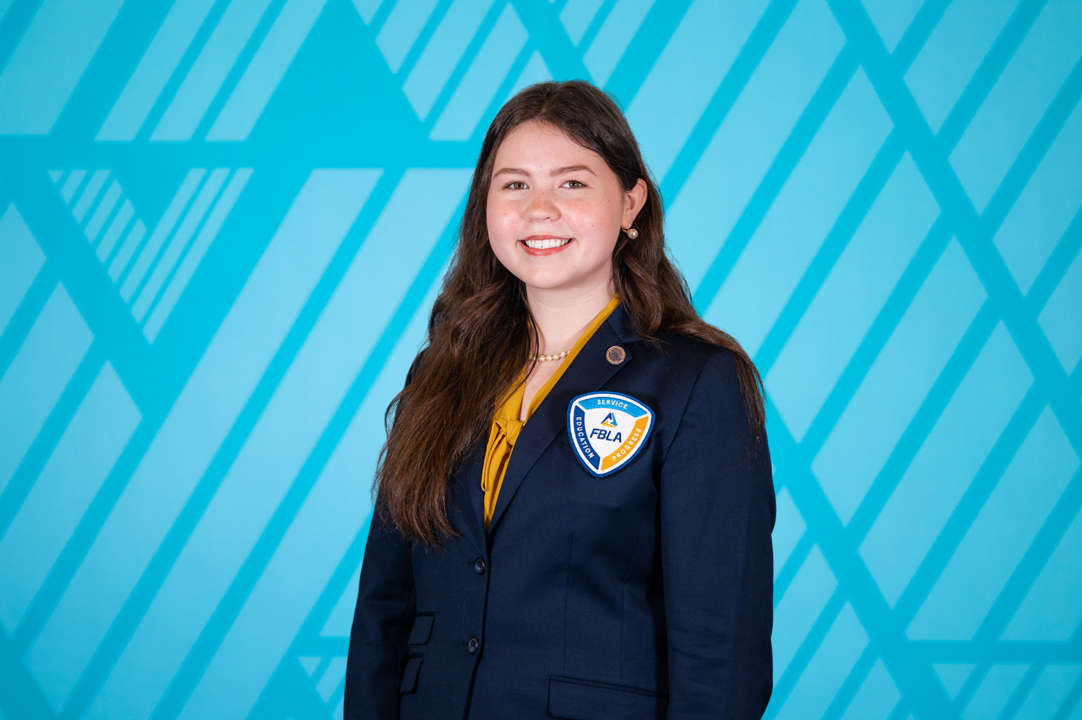
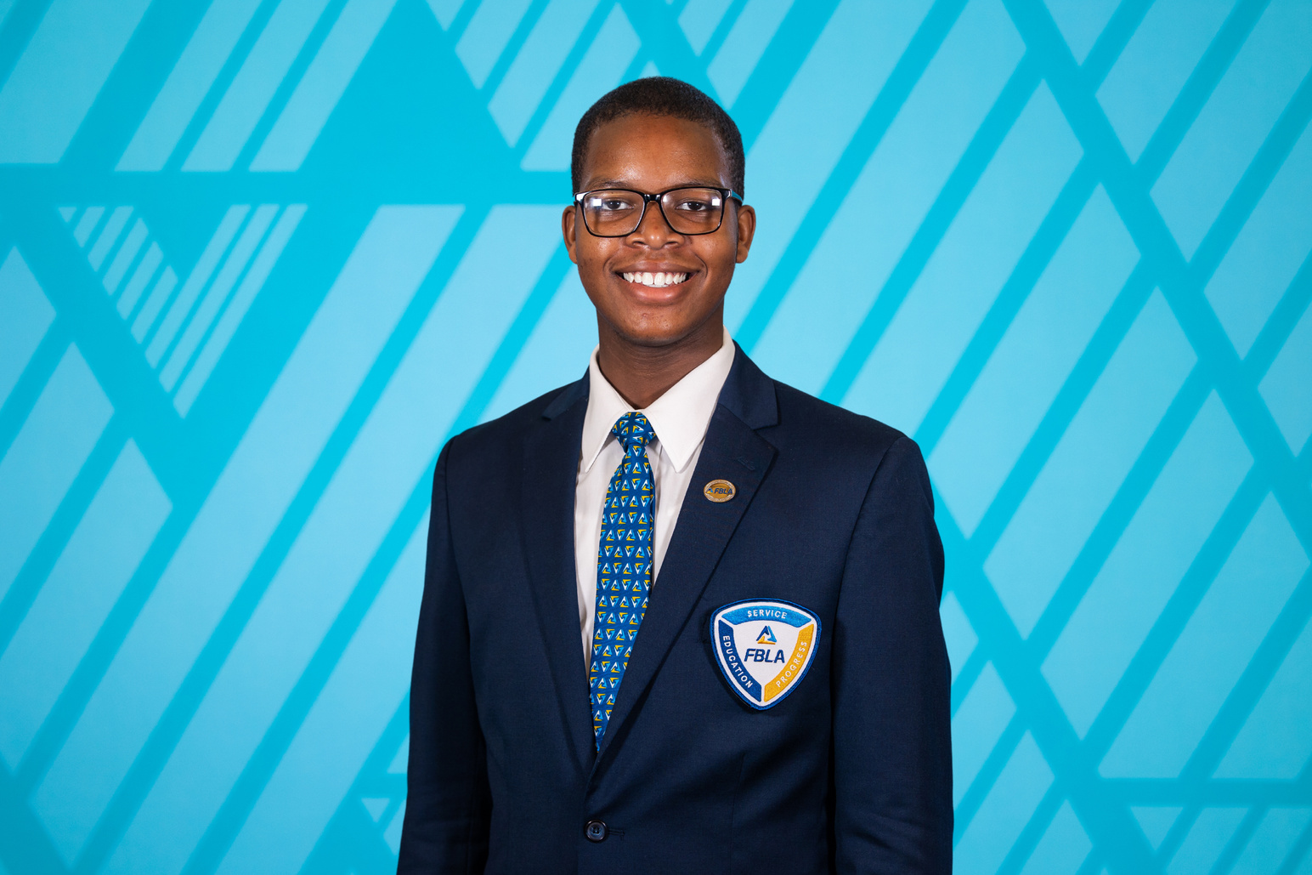
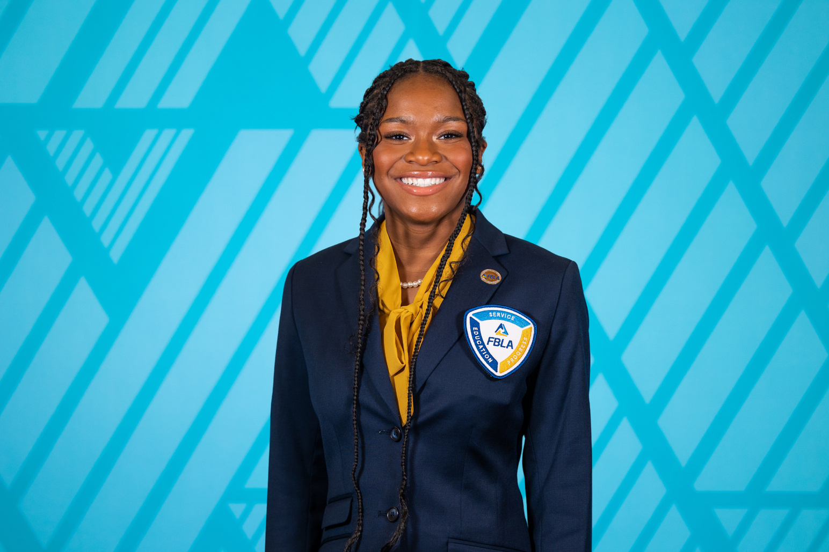
The State Officer Team
District I Vice President
Catherine McWhorther
Priceville High School
Adviser: Janet Cavender
District II Vice President
Jared White
Central High School, Tuscaloosa
Adviser: Monica Kirkman
District III Vice President
Armani Dixon
Saraland High School
Adviser: Vicky Crane

Slide 5
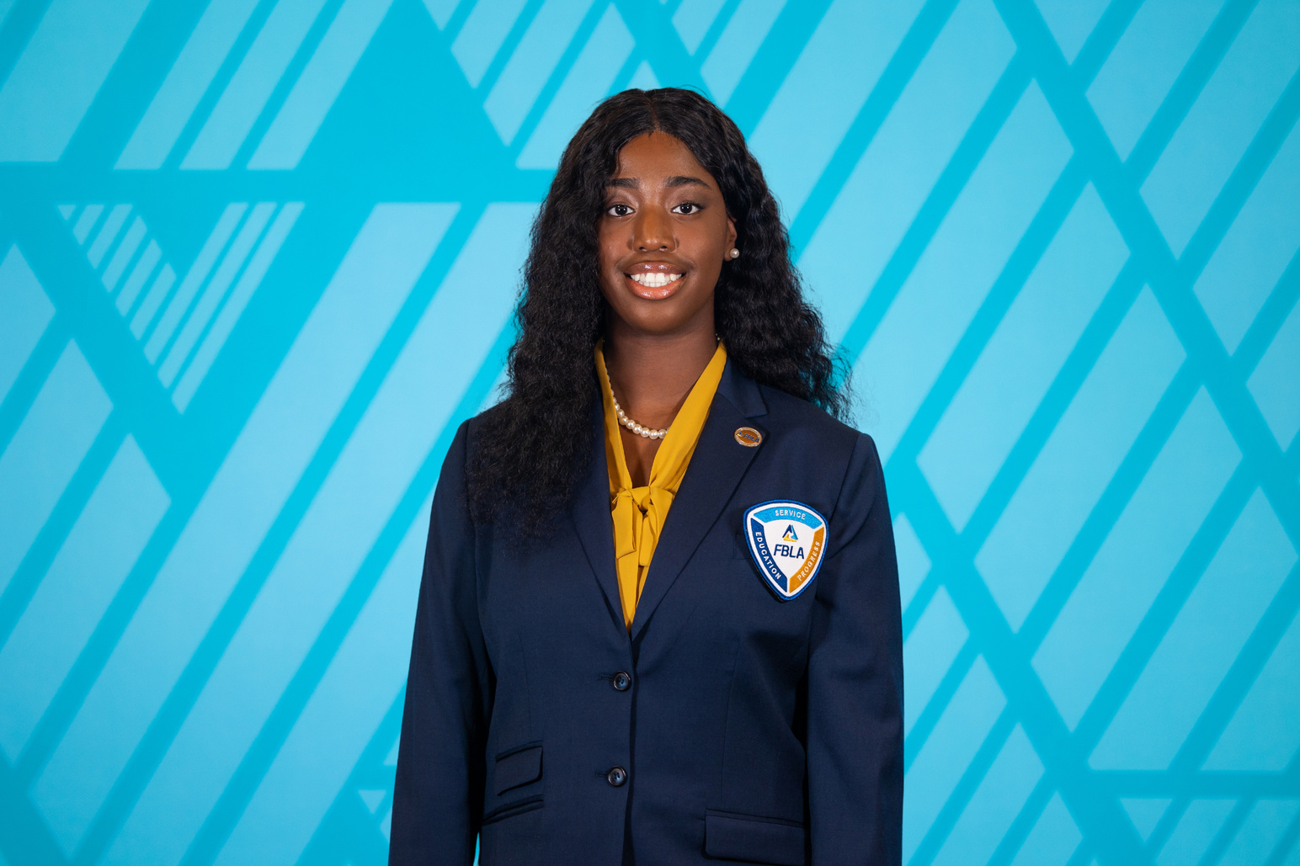
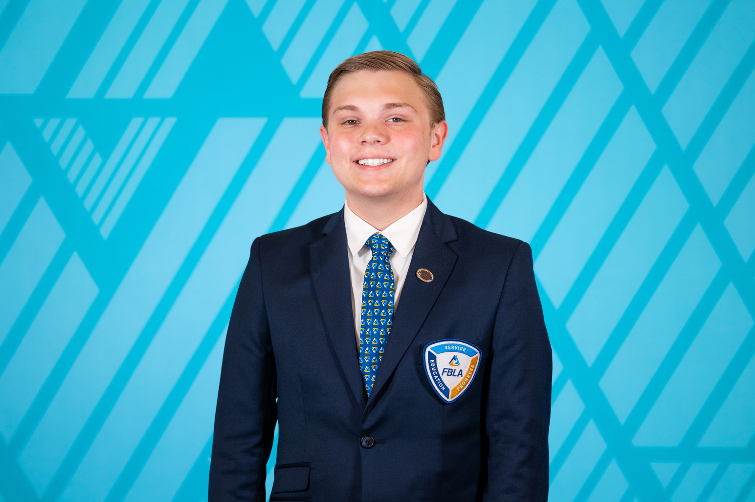
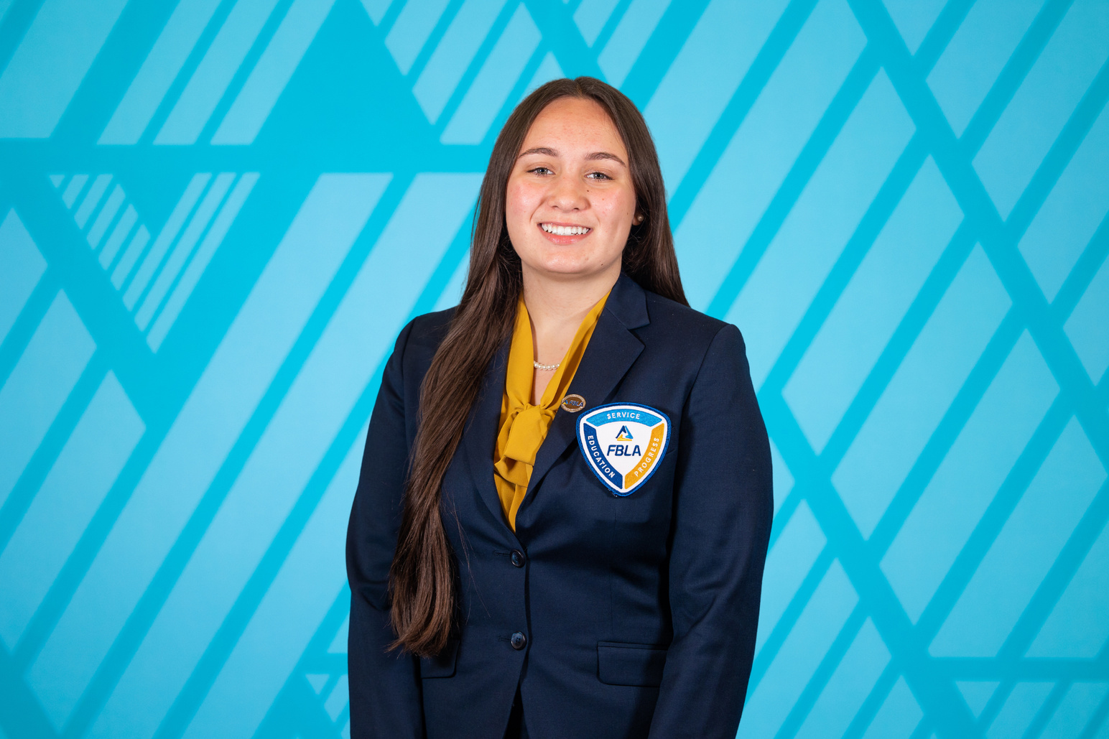
The State Officer Team
District IV Vice President
Shar'Dajai Harris
Lowndes County Career Technical Center
Adviser: Bridget Davis
District V Vice President
Carson DuBose
Eden Career Technical Center
Adviser: Gabe Lee
District VI Vice President
Greyson Sparks
Albertville High School
Adviser: Stacey Turner

Slide 6
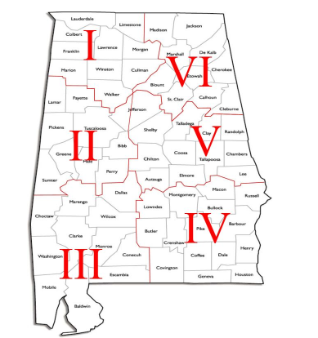
Alabama District Map
Interactive District Map
http://www.alfbladistrictmap.org/
Notes:
Another great way to raise money is to take donations and show a video like the one you are about to see.

Slide 7
State Officer Team Directory
Kendi McHargh | State President | Central High School, Tuscaloosa | alfblastatepresident2024@gmail.com
Madilyn Hanback | State Secretary | Rogers High School | alfblastatesecretary2024@gmail.com
Catherine McWhorter | District I VP | Priceville High School | alfbladistrict1vp2024@gmail.com
Jared White | District II VP | Central High School, Tuscaloosa | alfbladistrict2vp2024@gmail.com
Armani Dixon | District III VP | Saraland High School | alfbladistrict3vp2024@gmail.com
Shar'Dajai Harris | District IV VP | Lowndes County Career Technical Center | alfbladistrict4vp2024@gmail.com
Carson DuBose | District V VP | Eden Career Technical Center | alfbladistrict5vp2024@gmail.com
Greyson Sparks | District VI VP | Albertville High School | alfbladistrict6vp2024@gmail.com
Notes:
Another great way to raise money is to take donations and show a video like the one you are about to see.

Slide 8
State Officer Adviser Team Directory
Roslyn Evans | State President Adviser | Central High School, Tuscaloosa | revans@tusc.k12.al.us
Tisha Hanback | State Secretary Adviser | Brooks High School | tisha.hanback@lcschools.org
Janet Cavender | District I VP Adviser | Priceville High School | jgcavender@morgank12.org
Monica Kirkman | District II VP Adviser | Central High School, Tuscaloosa | mkirkman@tusc.k12.al.us
Vicky Crane | District III VP Adviser | Saraland High School | vcrane@saralandboe.org
Bridget Davis | District IV VP Adviser | Lowndes County Career Technical Center | bridgetdavis@lowndesboe.org
Gabe Lee | District V VP Adviser | Eden Career Technical Center | gabe.lee@sccboe.org
Stacey Turner | District VI VP Adviser | Albertville High School | sturner@albertk12.org
Notes:
Another great way to raise money is to take donations and show a video like the one you are about to see.

Slide 9
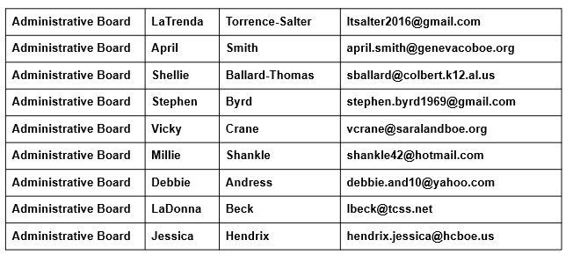
Administrative Board Directory
Notes:
Another great way to raise money is to take donations and show a video like the one you are about to see.

Slide 10
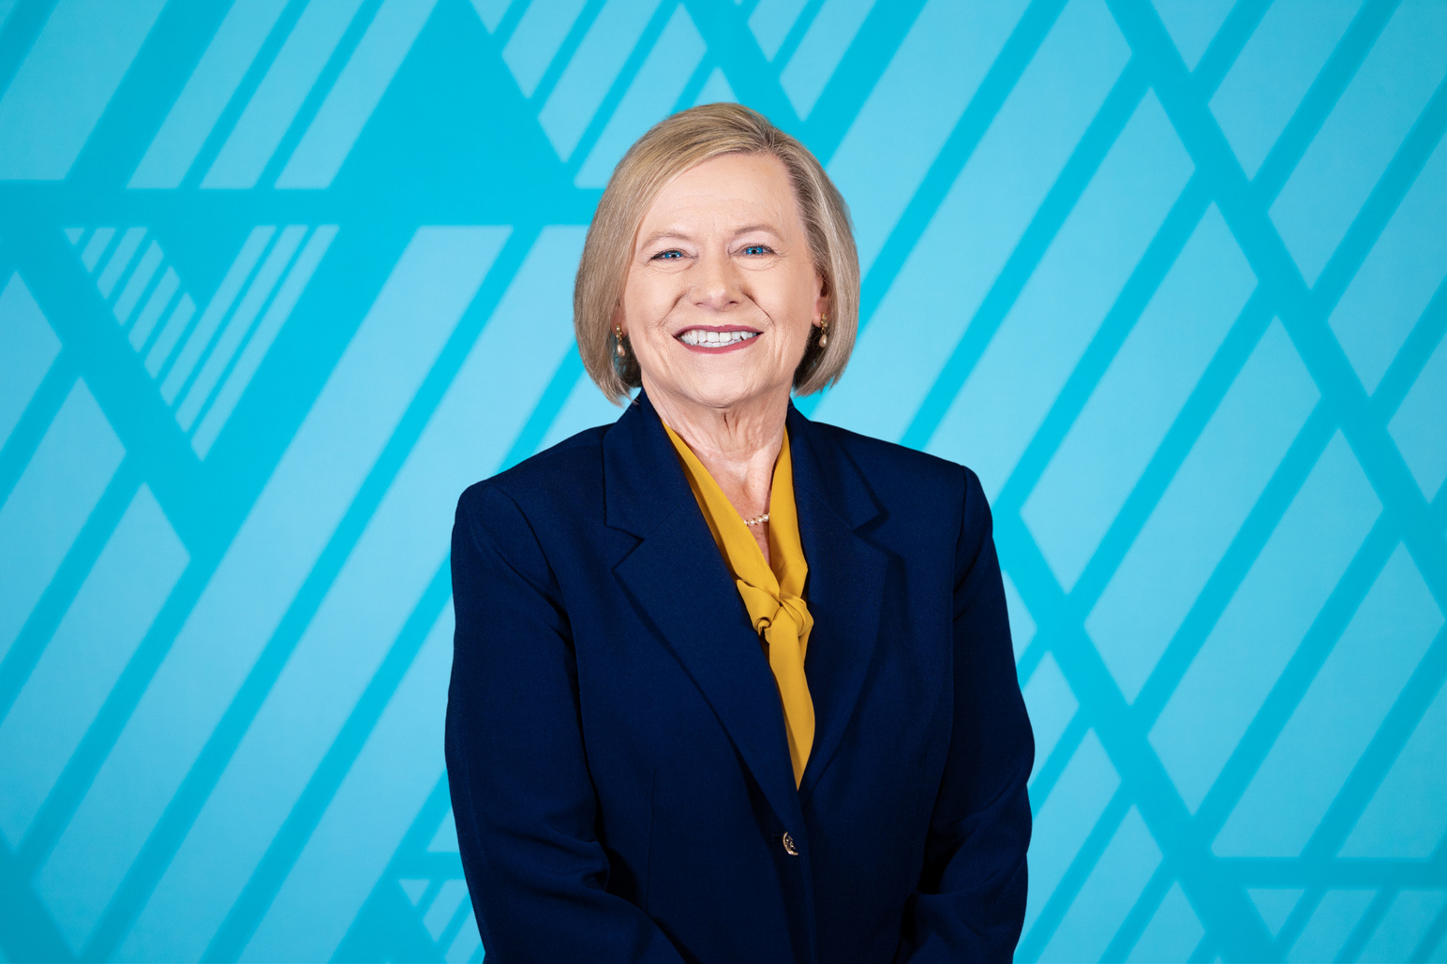
State Chapter Adviser
Lisa Weeks
FBLA State Adviser lweeks@alsde.edu
Alabama FBLA
P.O. Box 302101
50 N Ripley Street, Suite 3152
Montgomery, AL 36130
(334) 694-4757
Notes:
Another great way to raise money is to take donations and show a video like the one you are about to see.

Slide 11
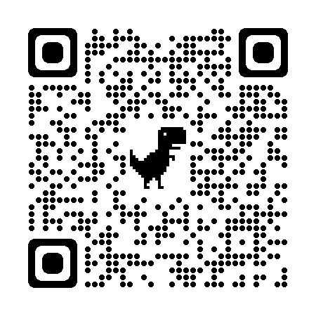
Utilizing The State Officer Team
Visits may be in person or virtual
Complete the Officer Visit Request Form found on the AL FBLA
website under the Resource section
  Yearly planning, program of work, blueprint, calendar, etc.
  Officer inductions
  Special chapter events
  Improving your chapter
  Officer Training
  March of Dimes activities
State Officer Visit Form

Slide 12

Websites
State Website:
www.alabamafbla.org
National Website:
www.fbla.org

Slide 13

Membership Deadlines
2023-2024 Membership Dues - Paid by March 1
(To be eligible to compete at NLC)

Slide 14

Membership Updates
FBLA High School Division
2021-2022 Membership 8,276
2022-2023 Membership 8,647
78.71% increase
FBLA Middle School Division
2021-2022 Membership 947
2022-2023 Membership 1,289
46.14% increase (4th largest Southern Region)
2023-2024
Goal - 11,200 members

Slide 15
Upcoming Conferences
Make sure your chapter is registered for the upcoming conferences.
  District Workshops - Learn leadership skills and network with others within your district
  ACE - Academy for Chapter Excellence (Presented by TriLeadership) https://alabamactso.org/events/ace/ - for Local Chapter Officers
  JLDC - Joint Leadership Development Conference (Presented by TriLeadership) https://alabamajldc.org/ - for all members
  NFLC - National Fall Leadership Conference https://www.fbla-pbl.org/nflc/
  SLC - State Leadership Conference
  NLC - National Leadership Conference

Slide 16

District Workshops
District I--October 24 Calhoun Community College District II--October 19 Northport National Guard Armory District III--November 1 The Bright Spot-Mobile | District IV-- October 31 (Tentative) District V-- TBD (Tentative) District VI-- October 10 (Tentative)
District I--October 24 Calhoun Community College District II--October 19 Northport National Guard Armory District III--November 1 The Bright Spot-Mobile | District IV-- October 31 (Tentative) District V-- TBD (Tentative) District VI-- October 10 (Tentative)
District I--October 24 Calhoun Community College District II--October 19 Northport National Guard Armory District III--November 1 The Bright Spot-Mobile | District IV-- October 31 (Tentative) District V-- TBD (Tentative) District VI-- October 10 (Tentative)

Slide 17


ACE
Academy for Chapter Excellence
A one-day program is designed for chapter leaders to gain the leadership and officer skills to effectively lead their CTSO programs at the local chapter level. Chapter leaders and advisors from all CTSO’s will gather to network, share best practices, discuss ideas, and grow their leadership.
Florence: Monday, September 11, 2023
Birmingham: Tuesday, September 12, 2023
Prattville: Wednesday, September 13, 2023
Mobile: Thursday, September 14, 2023
Virtual: Saturday, September 23, 2023

Slide 18

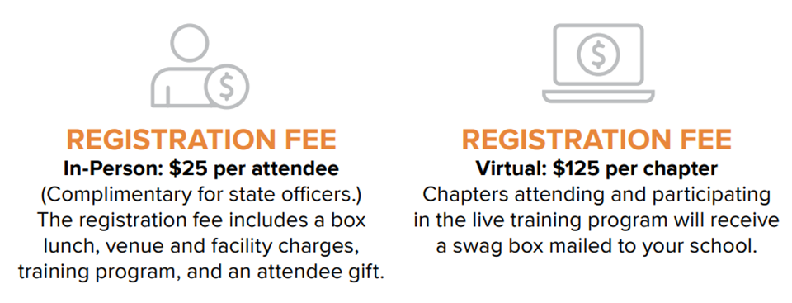

ACE
Academy for Chapter Excellence
OFFICERS
ONLY

Slide 19

JLDC
Joint Leadership Development Conference
The goal of JLDC is to build Alabama’s College+Career-Ready workforce with employability skills, leadership training, exposure to Alabama’s career opportunities, and increased knowledge of CTE+CTSO opportunities.
https://alabamactso.org/jldc/
Mobile: October 3, 2023
Huntsville: October 5, 2023
Virtual: October 13, 2023

Slide 20
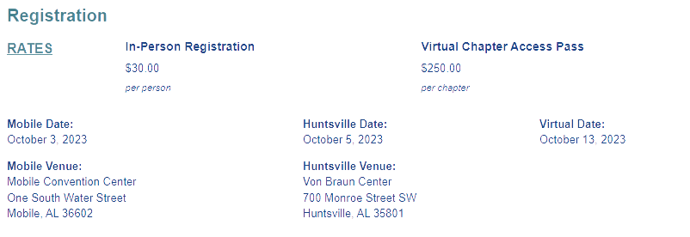
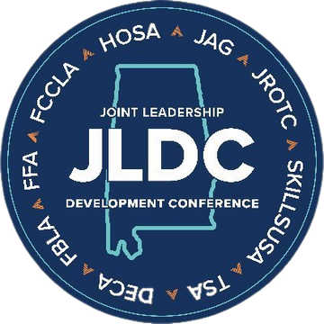
JLDC
Joint Leadership Development Conference

Slide 21
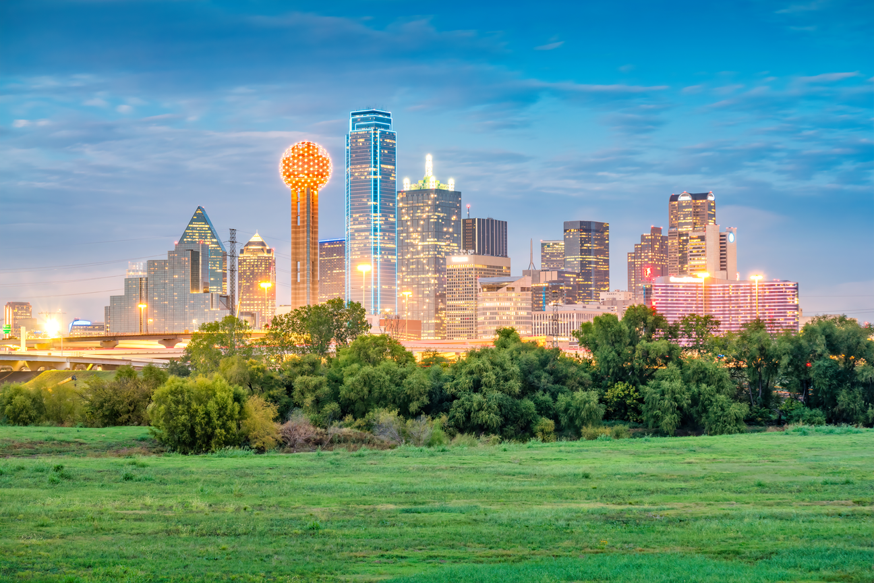
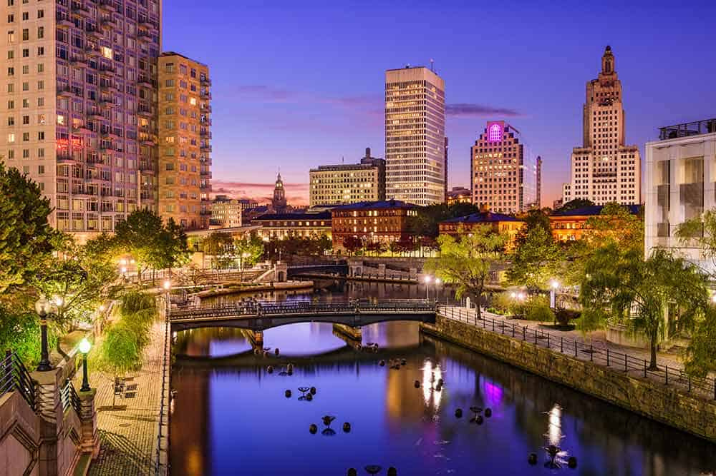

National Fall Leadership Conference (NFLC)
Mark Your Calendars
  Refine your business skills through interactive workshops
  Connect with colleges and universities
  Create a national network with other FBLA members
  Immerse yourself in a new city and new experiences
https://www.fbla-pbl.org/nflc/
PROVIDENCE, RI
NOV. 10-11, 2023
DALLAS, TX
NOV. 17-18, 2023

Slide 22

State Leadership Conference (SLC)
Mobile Convention Center
April 18-19, 2024
Champ Camp! - June 2024

Slide 23
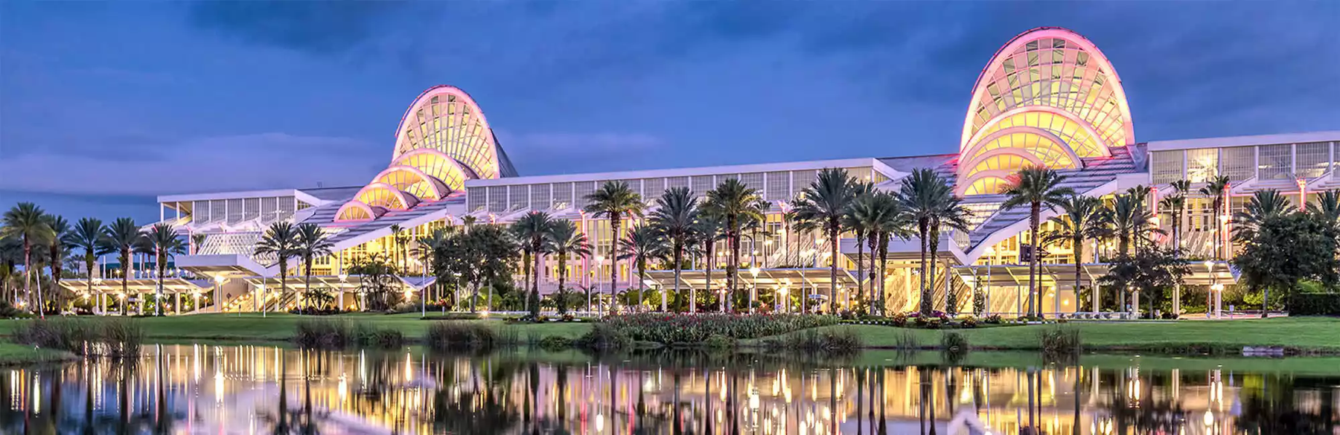
National Leadership Conference (NLC)
Orlando, FL
Collegiate: June 24-27
Middle School & High School: June 29-July 2
)

Slide 24
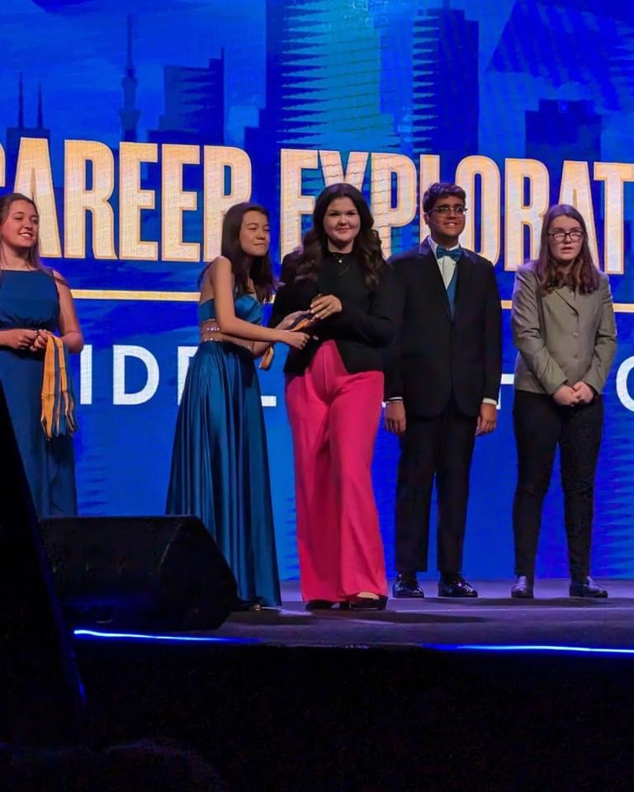
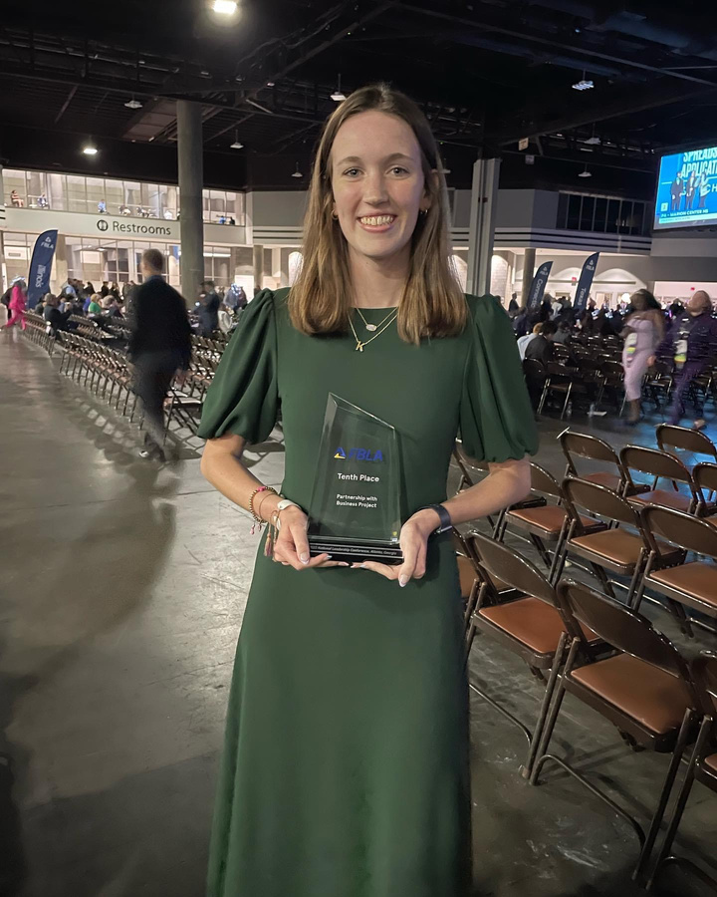
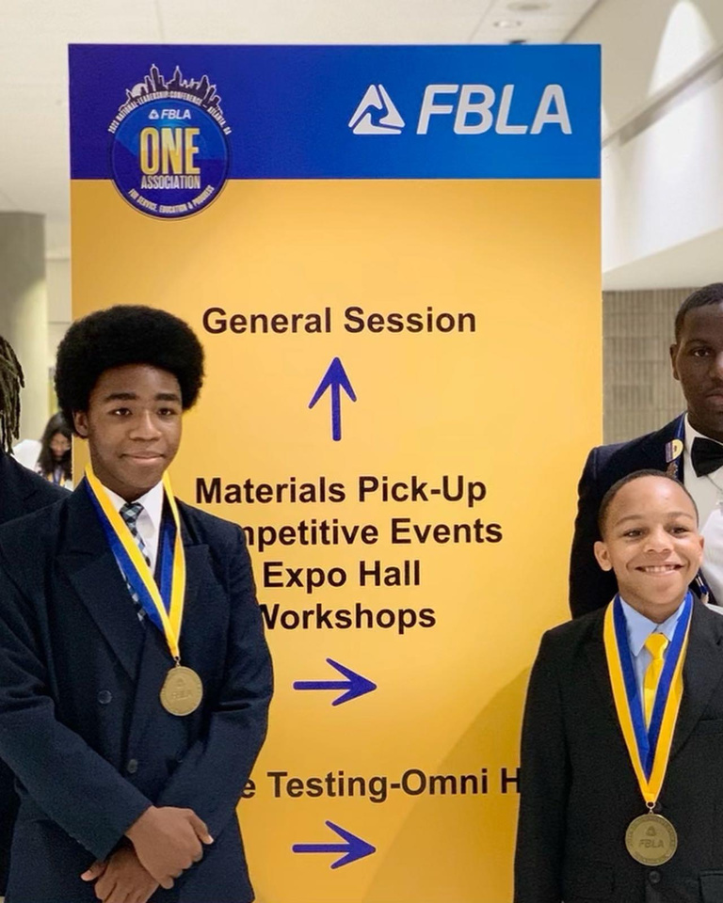
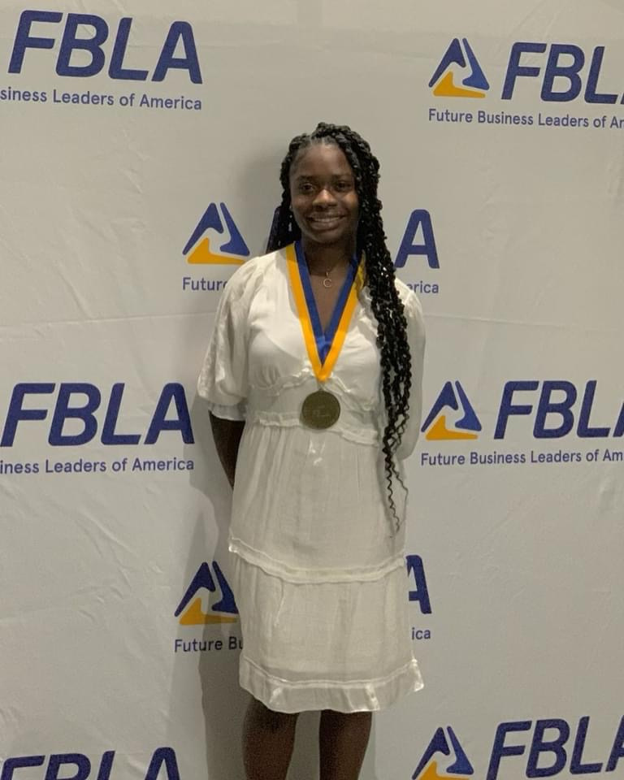
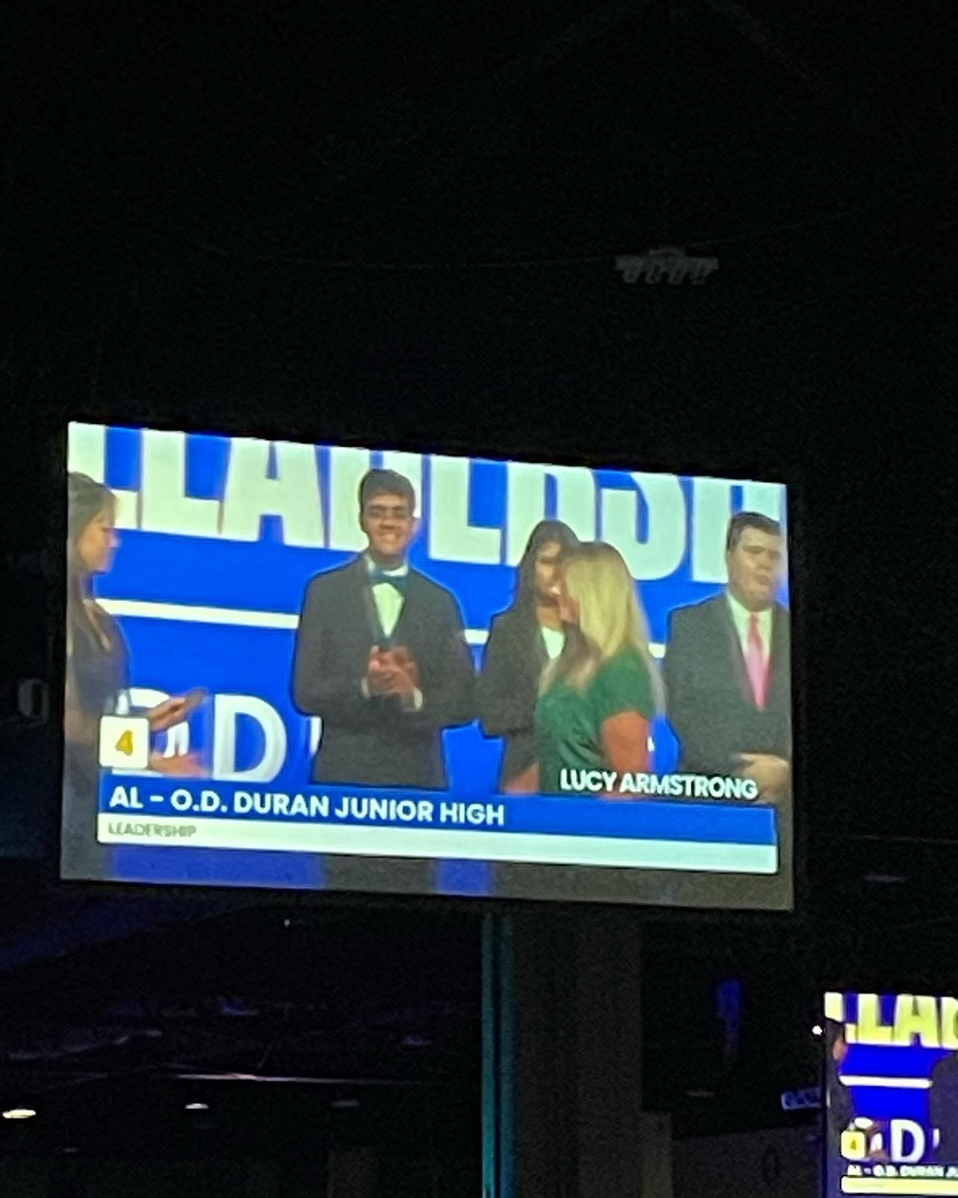
2023 National Leadership Conference
Congratulations to all winners & advisers!

Slide 25
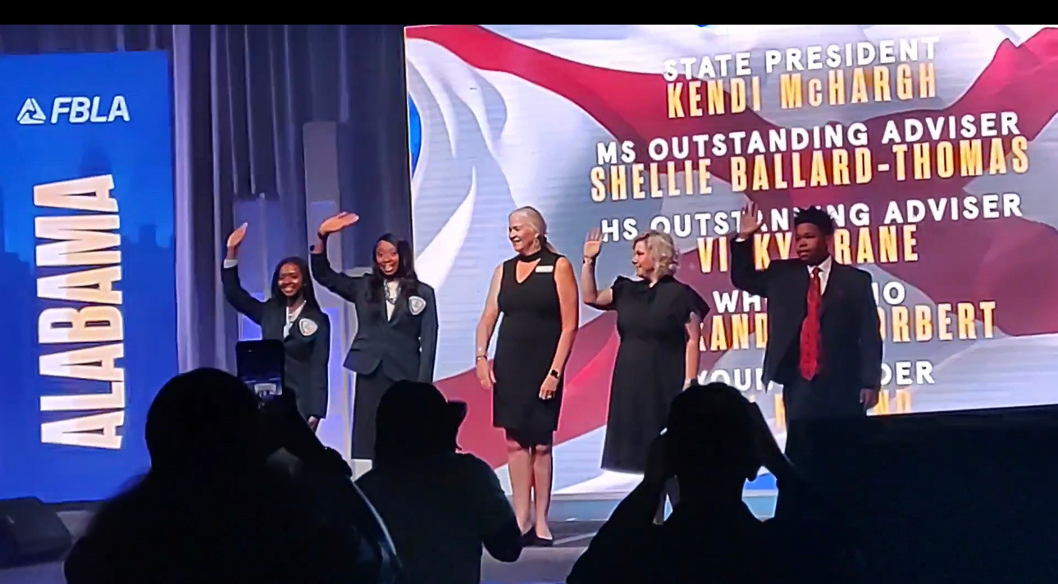
2023 NLC Awards and Recognition
State President: Kendi McHargh
Who's Who: Alexandria Torbert
Young Leader: MJ Rutland
Middle School Outstanding Adviser: Shellie Ballard-Thomas
High School Outstanding Adviser: Vicky Crane

Slide 26
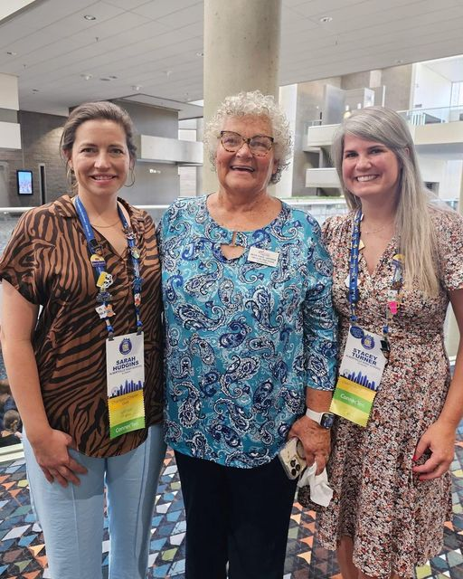
2023 NLC Awards and Recognition
Congratulations to Alabama FBLA!
Adviser Wall of Fame
Beth Todd, Albertville High School

Slide 27
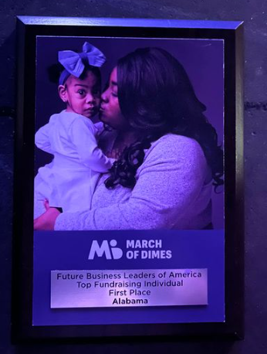
2023 NLC Awards and Recognition
Congratulations to Alabama FBLA!
Congratulations to Alabama FBLA for being named #1 Youth Fundraiser in the NATION for March of Dimes.
Our wonderful members and advisers raised $99,534.58 during the 2022-2023 school year.

Slide 28
2023 NLC Awards and Recognition
Middle Level Winners
Annual Chapter Activities-Preston Williams-School of Discovery
Career Research-Ciara Perkins-R.B. Hudson MS
Career Research- Mason Clements-Geneva County MS
Marketing MIx - Trisha Patel & Kelsey Scott - Saraland MIddle School
Career Research - Madi Brown - Saraland Middle School
Video Game Challenge - Parker Allums - Corner Middle School

Slide 29
2023 NLC Awards and Recognition
High School Top 15
Introduction to Public Speaking-Jeremiah Hall-Houston County HS
Sales Presentation- Darryl Honeycutt & Andarius Martin-Central HS Phenix City
10th PLACE!!
Partnership with Business Project-Kendal Nichols-Crenshaw Career Academy
BAA Capstone Level Member - Cassidie Steger- Geneva County HS

Slide 30
2023 NLC Awards and Recognition
1st Place |  | March of Dimes Top Fundraising State Chapters | Alabama FBLA HS
2nd Place |  | March of Dimes Top Fundraising Local Chapters | Central HS Tucaloosa
3rd Place |  | March of Dimes Top Fundraising Local Chapters | Geneva HS
1st Place |  | March of Dimes Top Fundraising State Chapters | Alabama FBLA MS
1st Place |  | March of Dimes Top Fundraising Local Chapters | Genesis School of Discovery
4th Place |  | Largest State Chapter - Middle School | Alabama FBLA MS
6th Place Middle School |  | Largest Chapter Merit Awards | Colbert Heights MS
4th Place |  | Largest State Merit Award Participation | Alabama FBLA MS
7th Place |  | Largest State Champion Chapter Award Participation | Alabama FBLA HS

Slide 31
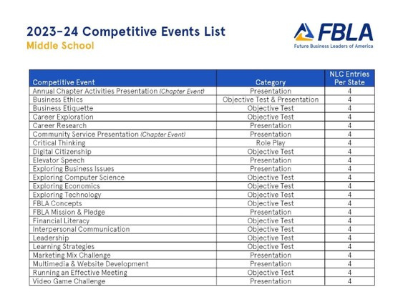
Competitive Events Updates
Middle Level
  No changes in events
  4 entries per state for NLC

Slide 32
Competitive Events Updates
High School Level
  Business Financial Plan > Financial Statement Analysis
  E-Business > Website Coding & Development
  Political Science > Public Policy and Advocacy
  Publication Design > Visual Design
  New Event: Future Business Educator
  New Event: Introduction to Programming

Slide 33




Stay Connected
Alabama FBLA has numerous ways to help our advisers have a successful chapter.
 | YouTube @AlabamaFBLA
 | Instagram @AlabamaFBLA
 | Twitter @AlabamaFBLA
 | Facebook @AlabamaFBLA

Slide 34

Stay Connected!
Join our Remind group to receive updates, reminders, and important information.
Text @alfbla2024 to 81010
*If you are already in an Alabama FBLA Remind group, there is no need to join the new group.

Slide 35

Chapter Resources
FBLA.org
Advisers Tab
  Lesson Plans, Forms, and Documents
  Champion Chapter (HS)
  MERIT Award (MS)
  BAA Registration (HS)
  LEAD Awards (MS)
  Membership Awards
  100% Class Participation
  and much more

Slide 36
Chapter Resources
AlabamaFBLA-PBL.org
Resources Tab
  Information regarding ACE, JLDC, SLC, NFLC, and NLC
  District Workshop
  Adviser’s Survival Guide
  Competitive Event Information
  State Officer Applications
  and much more

Slide 37
Individual Membership Recognition
LEAD Awards - Middle School
BAA - High School
Excellence Award (formerly CMAP) - Collegiate Level
*Deadline to submit for recognition is March 1

Slide 38
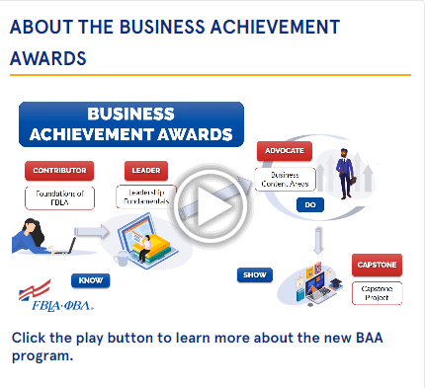
Business Achievement Awards
Four levels
Contributor Award (Level 1)
Leader Award (Level 2)
Advocate Award (Level 3)
Capstone Award (Level 4)

Slide 39
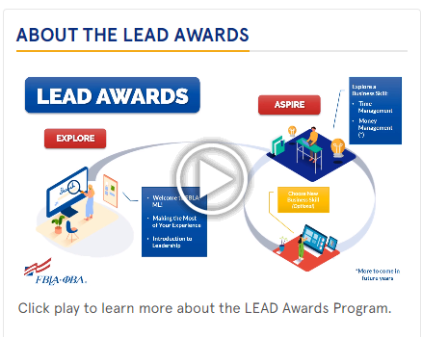
LEAD Awards
Two levels
Explore Award (Level 1)
Aspire Award (Level 2)
Notes:
EXPLORE AWARD - Level One - Members are introduced to the foundations of FBLA and learn how to best take advantage of the opportunities available to members through three courses: 1. Welcome to FBLA-ML, 2. Making the Most of Your Experience, 3. Introduction to Leadership
ASPIRE AWARD - Level Two - These 4-hours courses take a deep dive into specialized content areas. Courses may be repeated. New courses continue to be added throughout the year. NOW AVAILABLE: Time Management; COMING SOON: Money Management

Slide 40
Alabama FBLA Blueprint for Success
2023-2024 High School Blueprint for Success
2023-2024 Middle School Blueprint for Success
The goal of the Blueprint for Success is to encourage active chapters, help local chapters develop their programs of work,
and assist chapters and members in achieving recognition
and awards at the state and national levels.

Slide 41
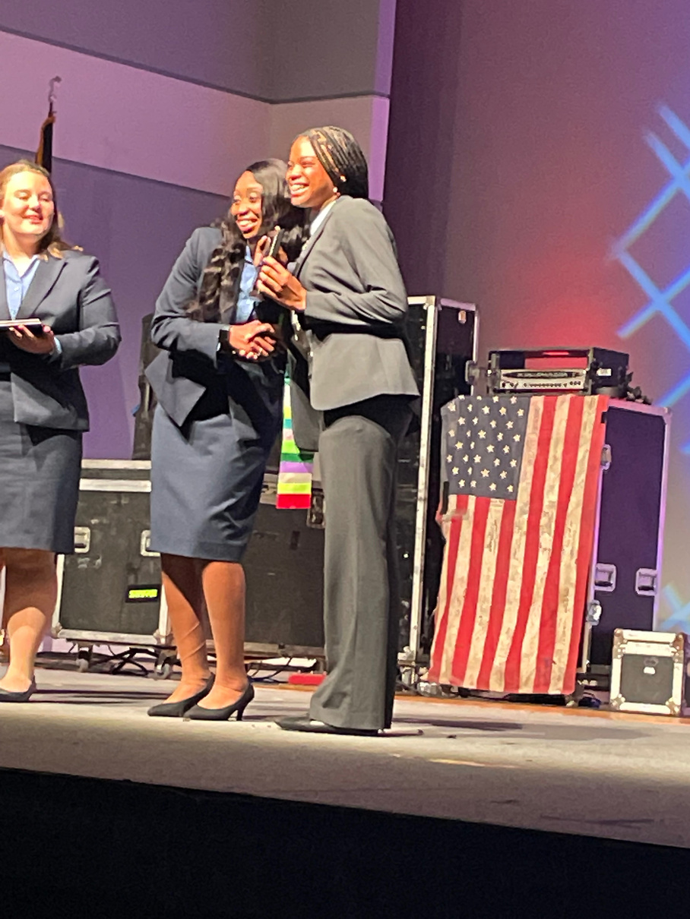
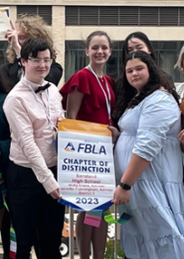
ALABAMA FBLA Chapter of Distinction
Required Tasks
  $200 or more donation to AL FBLA Foundation.
  Exceed 2022-2023 membership total by 12 members.
  Submit Local Chapter Program of Work by September 30, 2023 using this wufoo form: https://alabamafblapbl.wufoo.com/forms/m1lkh8i90gsnzuy/.
  Enter at least six (6) FBLA competitive events at the 2023-2024 FBLA SLC.
  Complete the 2023-2024 Blueprint for Success Outstanding Level
  Complete the Champion Chapter recognition program (national website).
  Have at least three members achieve one level of the Business Achievement Awards (BAA) in 2023-2024.

Slide 42
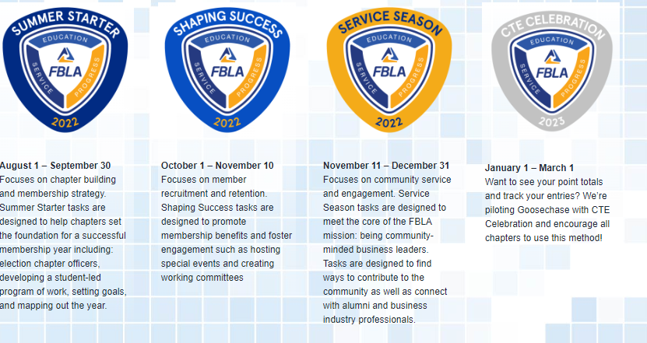
Champion Chapter

Slide 43
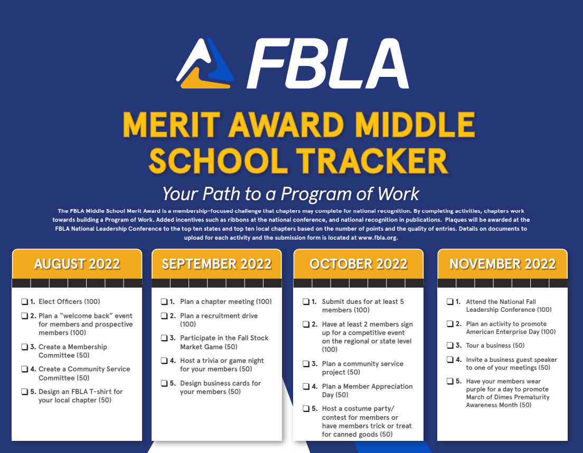
MERIT Award

Slide 44
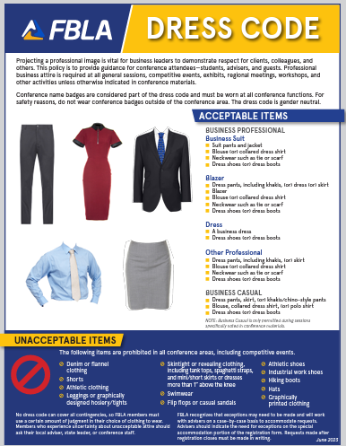
FBLA Dress Code
https://www.fbla-pbl.org/dresscode

Slide 45

March of Dimes
Alabama 1st in the Nation for donations to March of Dimes-$99,534.58
Chapter awards

Slide 46
March of Dimes
Fundraising Ideas for March of Dimes!
  Sell Blue Jeans for Babies T-Shirts
  Host a Mini-Walk or Run
  Sell March of Dimes cutouts and decorate your school
  Host a Mission Moment with your Elementary School
Alabama FBLA Contact
Ashley Gorum
Manager, Donor Development
Alabama Market
T 334-513-7380
M 334-320-5979
MARCHOFDIMES.ORG

Slide 47

March of Dimes
Mission Moment
Notes:
Another great way to raise money is to take donations and show a video like the one you are about to see.

Slide 49
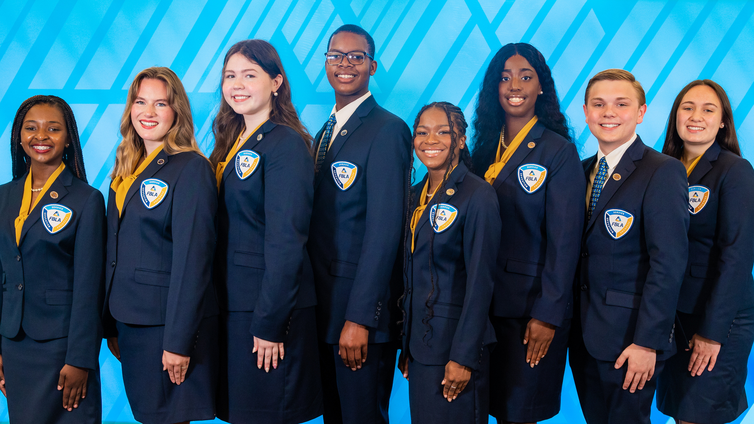
March of Dimes
Alabama 2023-2024
Goal: $82,500
Notes:
Another great way to raise money is to take donations and show a video like the one you are about to see.

Slide 50

Webinar Available for Advisers
August 15th, August 24th, August 31st @ 6:30 CST
September 7th @ 6:30 CST

Slide 51
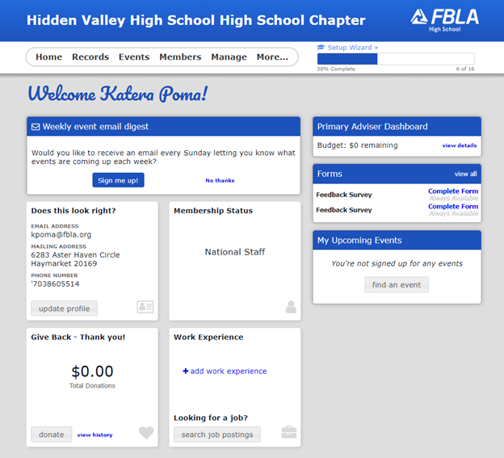

Slide 52
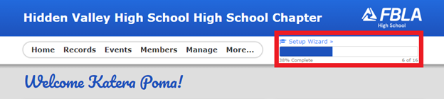
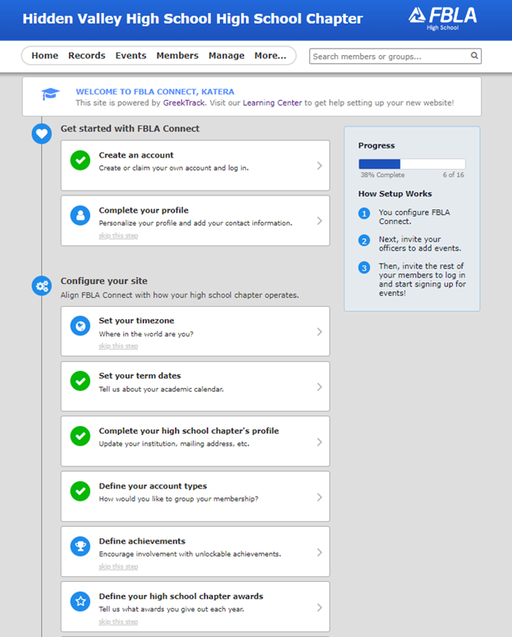

Slide 53
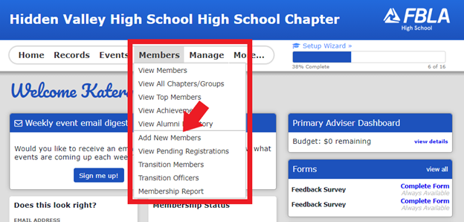

Slide 54
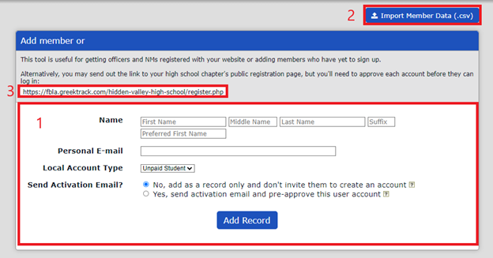
  Invitation
  CSV
  Enter one at the time
Add Members

Slide 55
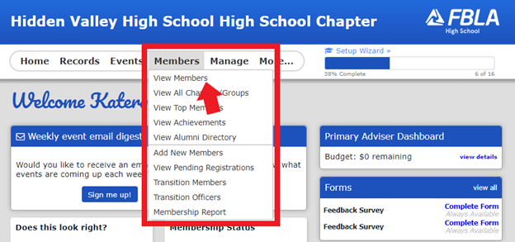
View Members

Slide 56
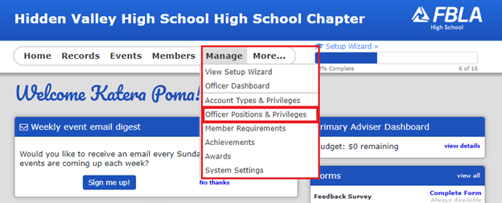
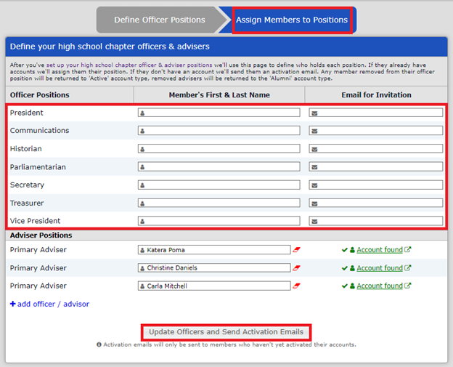
Officers and Positions

Slide 57
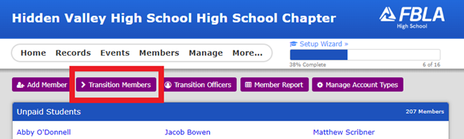
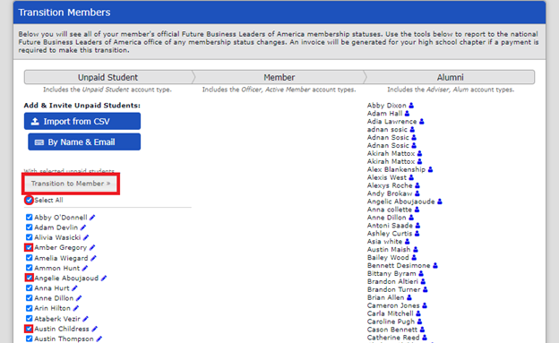
Transition Members

Slide 58
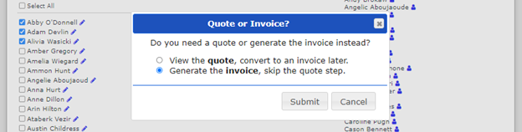
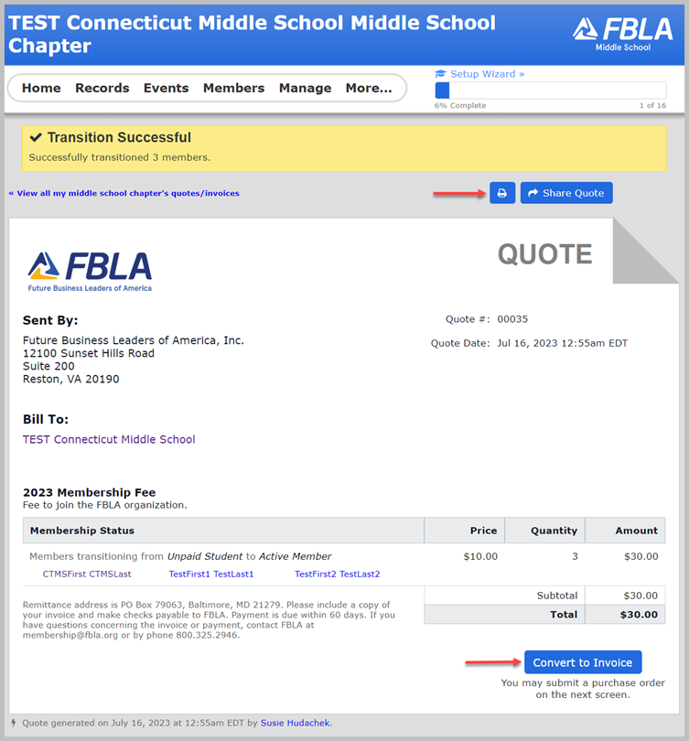
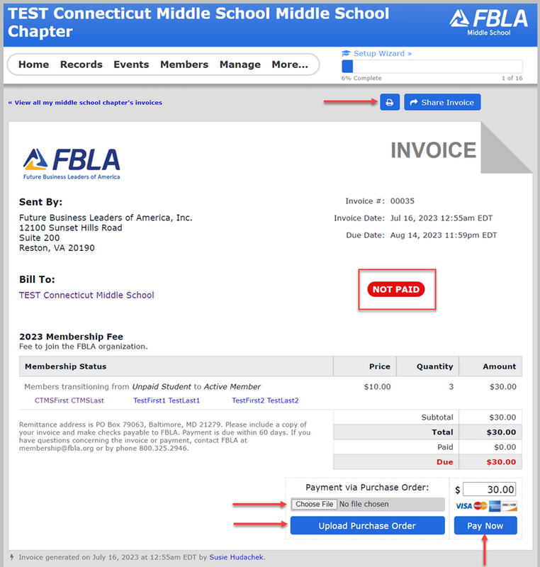

Slide 59
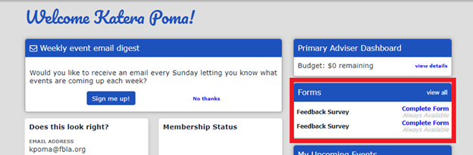

Slide 60
